Slide 1



West Midlands LINC Report - January 2026

Slide 2
West Midlands LINC Strategic Partners
Local Investment in Natural Capital strategic delivery partners

Slide 3

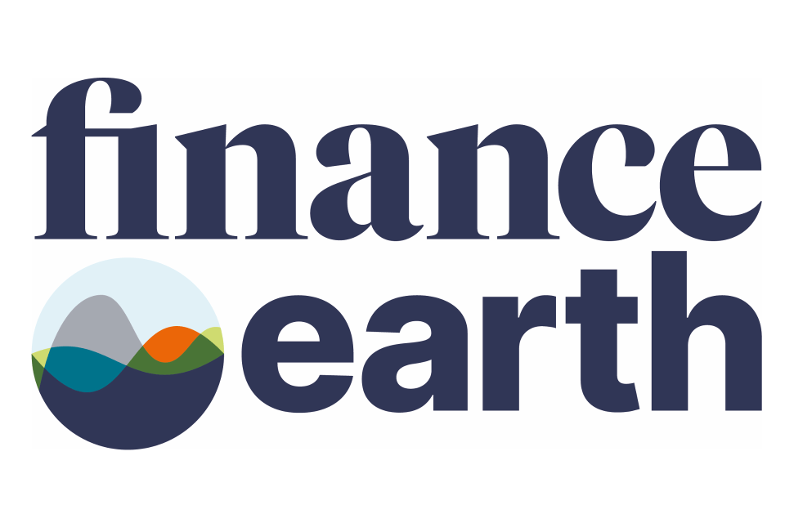







Programme development partnership
WMCA was supported in this work by a consortium of environment, finance and technical specialists, led by Finance Earth.
Finance Earth provide strategic insight and advice in the design of the programme and structuring of the Natural Capital Investment Facility.
Accelar lead supply side stakeholder engagement and market mapping, producing key insights into the need and capacity for a funding ecosystem for nature in the West Midlands.
Sustainability West Midlands is a regional sustainability hub and leads market consultation, representing a wide network of local businesses seeking to build a better West Midlands.
Specialist supporting partners:
3

Slide 4
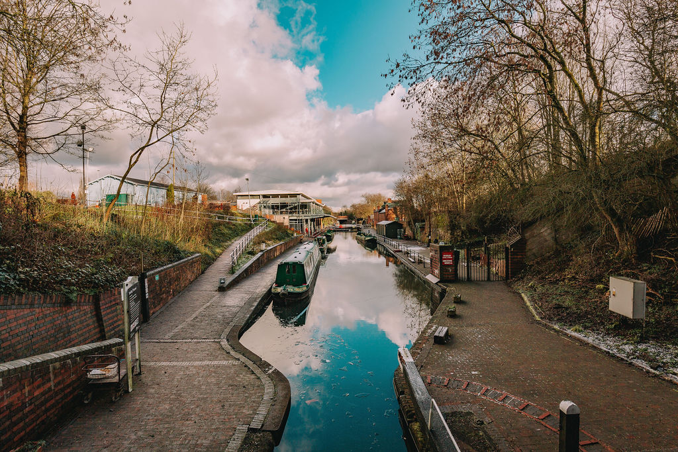
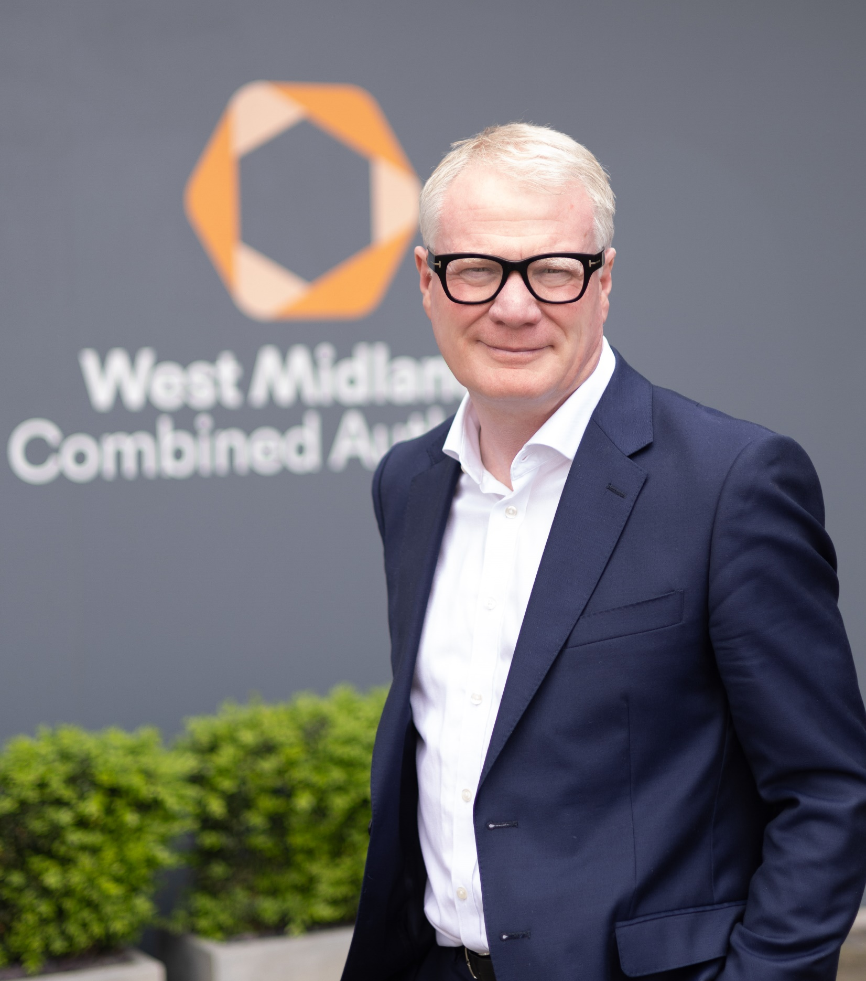
Foreword
The West Midlands Combined Authority (WMCA) is committed to protecting, restoring and enhancing our region’s natural environment; an ambition set out in the Natural Environment Plan. Since the Plan was launched, there has been significant progress across all priorities, including:
The WMCA is the responsible authority for the Local Nature Recovery Strategy, which will produce a comprehensive spatial plan for nature across the region.
The WMCA has become one of 4 pilot areas to receive funding from Defra to deliver a Local Investment in Natural Capital (LINC) programme to encourage private investment into natural environment projects.
The LINC programme is particularly exciting for the region as it will provide us with the opportunity to build a sustainable financing mechanism to support delivery of natural environment projects at scale. The Defra funding is enabling the production of natural capital investment plans to achieve the following outcomes:
Investment directed to priority areas.
Local areas able to access higher value finance.
Local leaders, communities and stakeholders empowered, included and committed to investment in nature recovery.
Local areas in a state of readiness to leverage and scale up private finance flow.
We know that national, regional, and local stakeholders will be fundamental to the successful delivery of this programme. We have worked with many already to develop a pipeline of projects for investment, but I would like to invite you to join the conversation and help us to deliver our natural environment ambitions for all people and places across the West Midlands.
Richard Parker
Mayor of the West Midlands
4

Slide 5

Contents
Executive summary 6
Natural capital in the West Midlands 7
Local Investment in Natural Capital programme 15
Evidence & market insights 23
Developing a regional-scale project pipeline 34
The West Midlands Nature Investment Hub 39
Accelerator programmes 43
Market roles, models, and governance 55
Conclusions and lessons learnt 63
Testimonials 68
Get in touch 69
5

Slide 6
Executive summary
The role of the West Midlands Combined Authority (WMCA) is to deliver a more prosperous and better-connected region which is fairer, greener and healthier. Achieving these ambitions requires an economic model for inclusive growth measured not only by how fast or aggressive it is, but also by how well it is shared equitably across the whole population and by the social and environmental outcomes it delivers.
The stock of natural capital assets in the WMCA region, including our waterways, trees, nature reserves and parks, provide social and economic benefits valued at over £600 million per year. These ecosystem services include flood mitigation, carbon capture, urban cooling, recreation, and improved health and wellbeing.
The DEFRA-funded Local Investment in Natural Capital (LINC) programme has provided the critical first step in implementing the system-level change and market intervention needed to build a nature-positive economy for the region by 2030. The LINC programme requires the WMCA to commit to being in a state of readiness to access and bring in local/regional investment at a strategic level through the establishment of a pipeline of projects and a vehicle or mechanism to direct investment to local natural capital priorities.
The outputs delivered, and lessons learnt so far, demonstrate a potential to generate £35 million in revenue from sales of Biodiversity Net Gain (BNG) units from just 7 local authority pilot sites. Key outputs from phase 1 include:
a natural capital pipeline of over 200 stakeholder projects
a beta-version market-facing platform to attract investment and funding
financial modelling for a regional approach to delivering BNG
case studies, economic assessments and market research
Strategic engagement with our regional partners has been a core pillar of the LINC programme. Over 100 workshops, webinars, and events have enabled a collective endeavour at a regional scale, to deliver local priorities and address the challenges identified by government and articulated in the Green Finance Strategy (2003).
The WMCA is one of 48 ‘Responsible Authorities’ across England producing a Local Nature Recovery Strategy (LNRS); a statutory requirement through the Environment Act 2021. The LINC programme will provide the mechanisms to fund and deliver the priority actions identified in the West Midlands LNRS.
By working at a regional level, the WMCA’s ambition has been to increase the scale and range of investment propositions, enhance strategic coherence, de-risk across a portfolio of projects, increase market confidence, and provide a single point of entry for investment to improve green and blue infrastructure in and around our towns and cities.
Looking ahead to 2030, WMCA will continue to work with government and regional stakeholders to build a sustainable funding ecosystem and the regional market infrastructure which will unlock private and public sector investment and funding to:
support inclusive growth and the green economy
increase opportunities for green and blue infrastructure to deliver net zero targets, and provide climate mitigation and adaptation
deliver place-based improvements in our towns and cities
improve health and wellbeing through accessible greenspace
support delivery of the West Midlands Local Nature Recovery Strategy
​
6

Slide 7
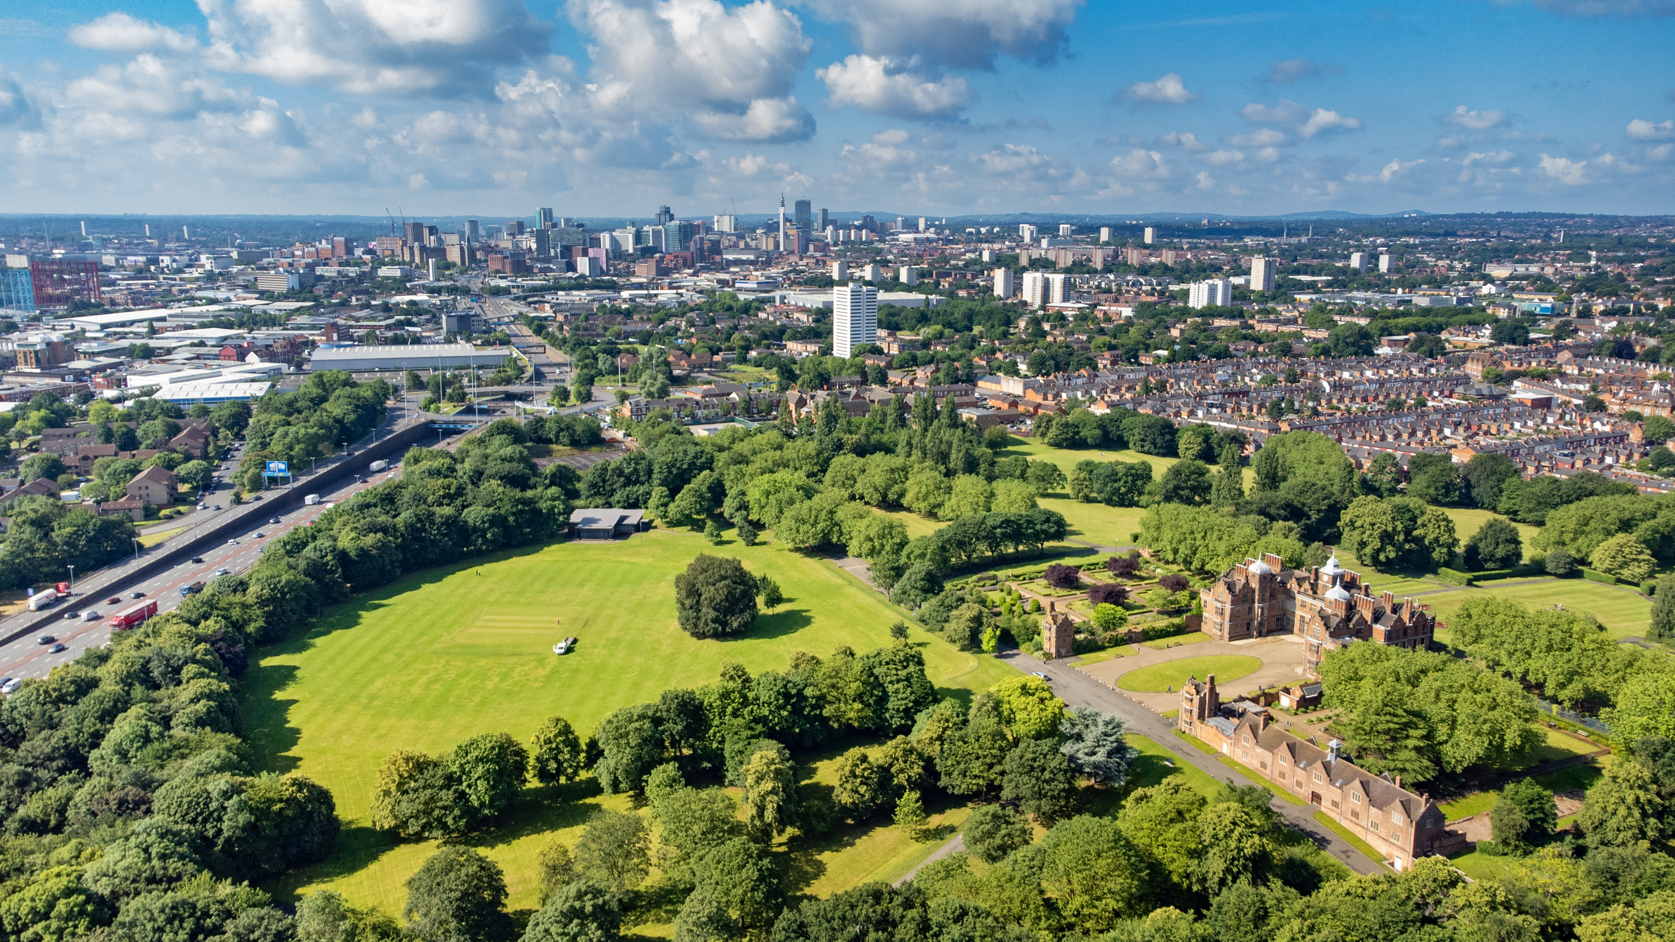
Natural Capital in the West Midlands

Slide 8
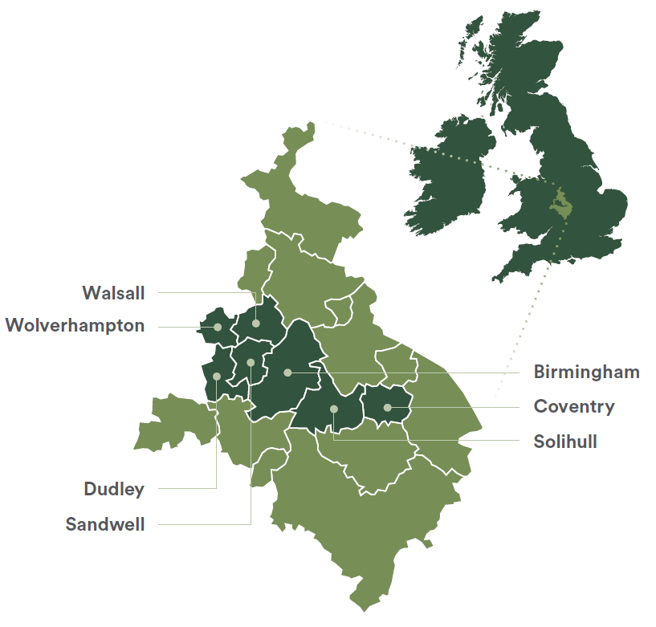

West Midlands Combined Authority
The West Midlands Combined Authority (WMCA) was set up in 2016. WMCA is made up of 18 local councils. With a population of 4.7 million people, the wider WMCA region has the largest economy of any combined authority area in the UK at £118 billion (2023).
The core 7 constituent local authorities are home to 2.9 million people, one of the youngest and most ethnically diverse populations in Europe. The 2021 census for the 7 constituent authorities valued their gross domestic product (GDP) as £74.2bn.
Historical industrialisation has led to a highly urbanised environment, especially in Birmingham, Coventry and Wolverhampton, while subsequent deindustrialisation has resulted in significant inequality and economic disparity. The ‘Summary of Climate Change Impacts in the WMCA Area,’ (WMCA, 2022) demonstrates that issues such as extreme heat, flood risk and degradation to infrastructure are exacerbated by this urbanisation and have knock-on effects in terms of health and economic outcomes. Physical and mental health outcomes remain poor, with life expectancy below the national average.
We have seven constituent local authority members that make up the WMCA Board (Birmingham, Coventry, Dudley, Sandwell, Solihull, Walsall and Wolverhampton). Our work to unlock private investment in the natural environment will primarily be focused on the geography of the core constituent authorities.
8

Slide 9
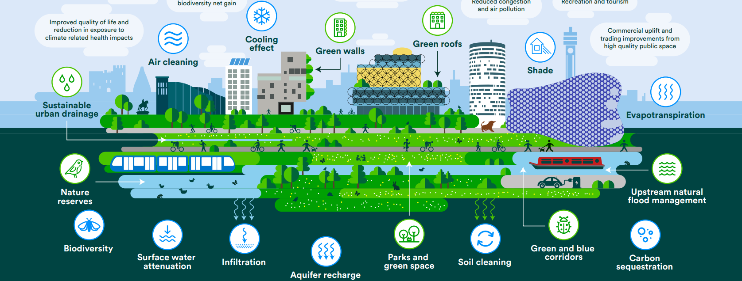
The West Midland’s natural capital
The region's natural environment is a vital resource, providing over £600 million per year in socio-economic benefits for our diverse communities and businesses.
The WMCA region has a unique patchwork of post-industrial landscapes, 520 miles of canals, parks, brownfield sites, surrounding greenbelt and an urban forest comprising an estimated 4.9 million trees.
This natural capital holds huge potential to reverse the decline in biodiversity, build resilience to climate change and support the West Midlands in becoming a more prosperous place to live, work and visit.
The benefits of these ecosystem service include:
Health and wellbeing
Social and cultural value
Climate resilience to heatwaves and flood risk
Removing air pollution and carbon dioxide from our atmosphere
Education, learning and green jobs
Economic uplift via the green economy
Community engagement with nature and green spaces
9

Slide 10







WMCA natural capital headlines
200+ projects in the regional natural capital pipeline
£100+ million funding gap to deliver pipeline projects
70% of projects are scalable or replicable
£20+ billion value of natural capital assets
£56 million annual value of carbon capture from natural capital
£600+ million annual health and recreation value of natural capital
10

Slide 11
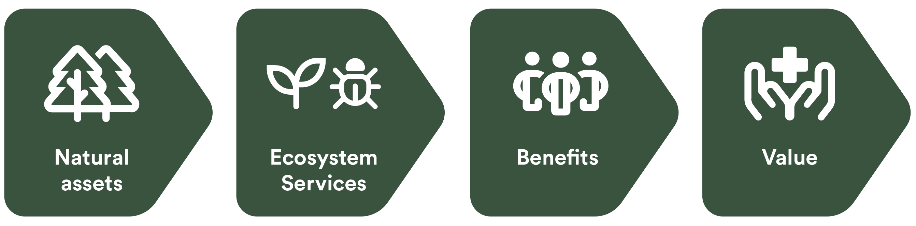
What is “natural capital” and why is it critical?
Natural capital can be defined as the world’s stock of natural assets, which include soil, geology, air, water, and all living things. The term “natural capital” recognises that nature provides a wide variety of benefits and value to people, society and the economy. These ecosystem services include climate regulation, food, raw materials and energy, making life possible. Pressures on nature result in costs to society and the economy.
Taking a natural capital approach develops our traditional understanding of how the economy works. Following on from the UK National Ecosystem Assessment and the work of the Natural Capital Committee (an independent government advisory group 2012-2020) nature is now being valued as an asset class alongside infrastructure, energy, skills, and technology. This new approach allows us to account for the economic and social benefits which arise from sustainably managing and investing in our natural assets.
Our spaces, particularly within towns and cities, need to be designed to benefit people, businesses and nature. Urban nature-based solutions like green walls and roofs, sustainable drainage systems and street trees have the potential to provide around 30% of the climate adaptation needed to protect our towns and cities from increased rainfall, flooding and heatwaves by 2030. They can also increase commercial value, provide insulation, improve air quality, capture carbon, enhance health and well-being and help create healthy, vibrant, active green towns and cities.
The continued deterioration of our natural environment could lead to an estimated 12% loss to GDP.
Nature is a form of economic capital, which the UK economy is dependent upon.
The UK has become one of the most nature-depleted countries on earth.
11

Slide 12
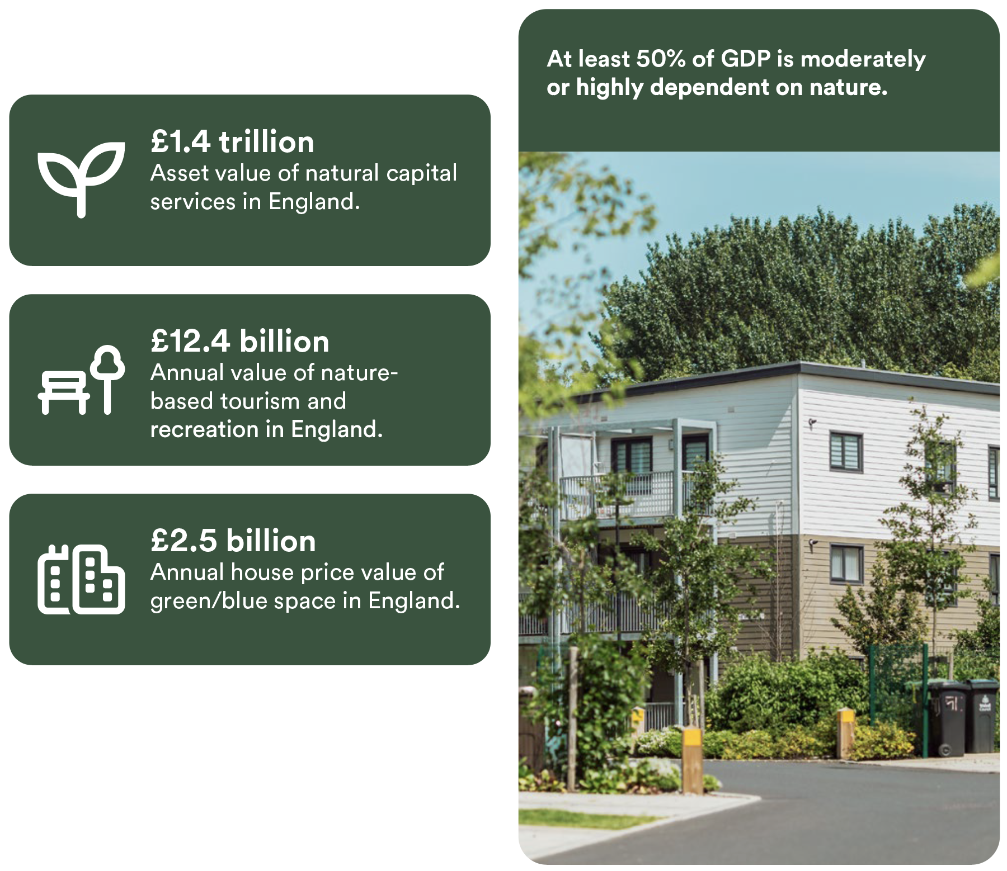
Natural capital
and inclusive growth
The national value of natural capital
What is inclusive growth?
The WMCA Inclusive Growth Framework establishes a more deliberate and socially purposeful model of economic growth - measured not only by how fast or aggressive it is but also, by how well it is created and shared across the whole population and place, and by the social and environmental outcomes it realises.
To unlock the potential of the West Midlands and achieve our ambitions for inclusive growth, economic models must incorporate and account for natural capital. The health of our natural capital is everyone’s business as at least 50% of GDP is dependent on the complex array of provisioning, regulating, and supporting services provided by nature.
The region’s natural capital is both an economic resource and an enabling asset: providing services which businesses can monetise; enabling communities to live healthier and happier lives; and enabling the creation of green jobs. Research shows that investing in nature-based solutions can generate 3.7 times as many jobs as investment in fossil fuels.
12

Slide 13
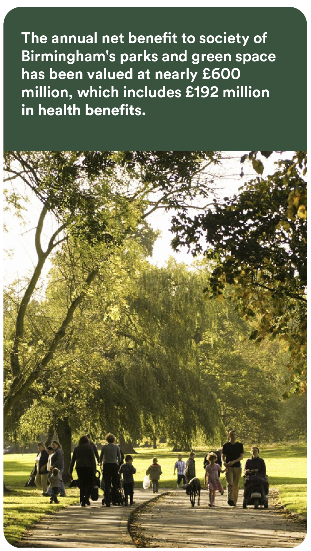
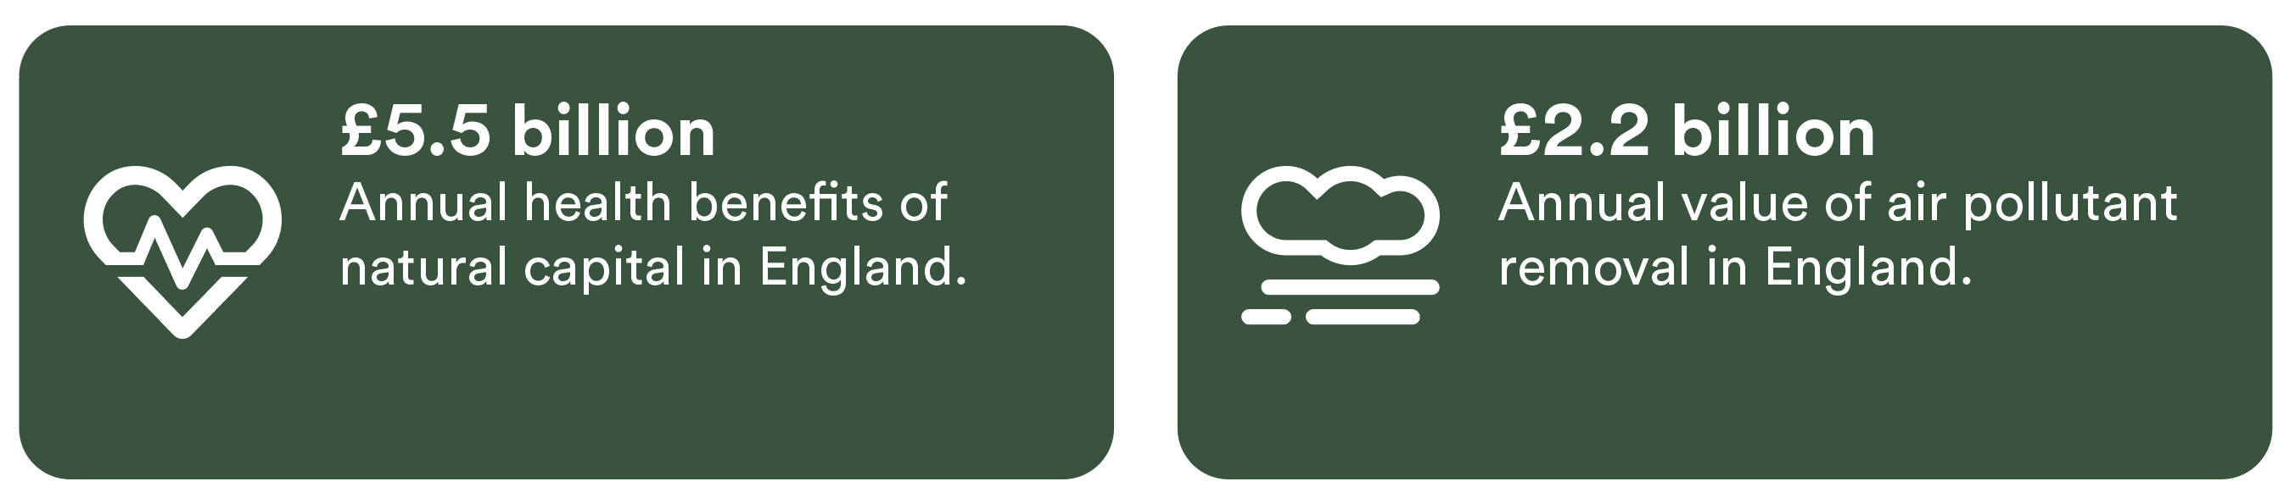
Health, wellbeing and natural capital
The WMCA area continues to have poorer health outcomes than the national average. The West Midlands also has one of the lowest national rankings for equitable access to green space.
Evidence shows that people with greater access to green space have better levels of general health, higher life satisfaction and lower levels of depression. Research also identifies stronger health outcomes for those in the most deprived groups, demonstrating the importance of access to green space in addressing socioeconomic health inequalities. It is estimated that £2.1 billion per year could be saved in health costs if everyone in England had good access to green
space for outdoor activity. Natural capital can also have a direct health benefit, with air
pollution removal from trees in the WMCA totalling an annual value of £15 million.
Mental ill health is the single largest cause of disability in the UK. The wider economic costs of mental illness in England have been estimated at £105 billion each year. Greener environments have been shown to reduce levels of depression, anxiety, and fatigue, with the beneficial effects greatest for socioeconomically disadvantaged groups. Green workspaces and workers with a view of nature were linked to a 23% drop in sick leave, greater job satisfaction, and a greater likelihood of better staff retention and morale.
The national value of natural capital
13

Slide 14
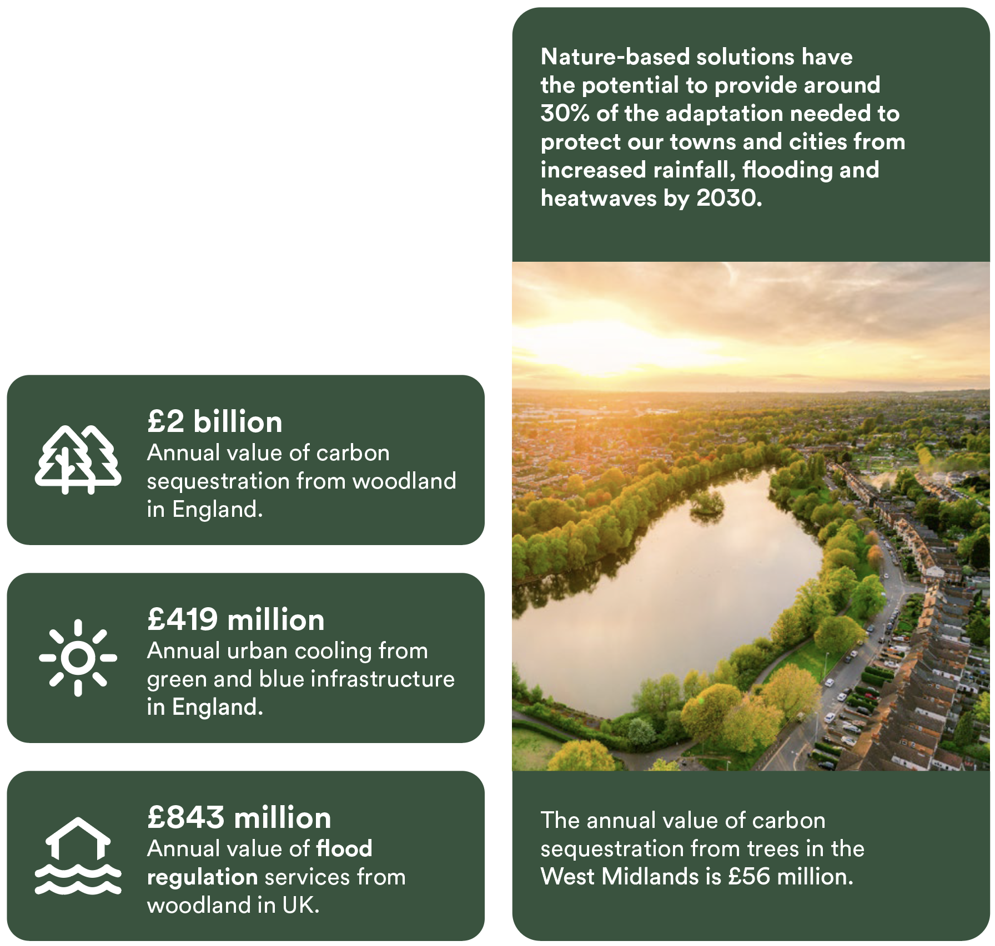
Climate resilience and adaptation
The UK’s natural capital provides £billions annually in nature-based solutions for climate change mitigation and adaptation. These regulating services include carbon sequestration, urban cooling, aquifer recharge, and flood mitigation.
The total cost of climate change impacts to the UK are projected to increase from 1.1% of GDP at present to 3.3% by 2050. Three recent severe weather events were collectively estimated to cost the WMCA area around £21 million, with impacts affecting all aspects of the region’s Inclusive Growth Framework. By 2030, GVA in the WMCA area could be reduced by £350- £638 million a year due to climate change.
Flood events are associated with a range of social, economic and health impacts to households, businesses and communities. It is estimated that 50% of the UK’s socially vulnerable people living in flood risk areas are located in just 10 local authorities: Birmingham is one of these high-risk areas.
Increased heat levels associated with climate change have impacts on morbidity and acute
increases in hospital admissions. The summer of 2018 saw 19% of dwellings overheat. The Office for National Statistics has also valued the annual productivity losses from heatwaves at £31 million per year.
14

Slide 15

Local Investment in Natural Capital Programme

Slide 16
Why is investment in nature needed?
Over £6 billion of average annual investment is needed for the next 10 years for the UK to deliver its nature related commitments.⁽¹⁾ Unlocking new forms of funding will allow existing funds to do more for high impact projects that are harder to monetise.
Required spending
£8.8 billion annually for the UK (average estimated)⁽¹⁾
£6.1 billion average annual funding
gap for UK nature⁽¹⁾
£2.7 billion committed and planned spend⁽¹⁾
GFI, eftec, Rayment Consulting. 2021. The Finance Gap for UK Nature; central estimates used.
Nature-related outcomes are based on public policies, e.g., the 25 Year Environment Plan in England and equivalent for the rest of the UK. Spending with the intention to contribute to the delivery of each outcome is reported but whether such intention is sufficient to meet the outcome is not assessed.
NFM: Natural Flood Management
16

Slide 17

WMCA Local Investment in Natural Capital (LINC)
LINC Phase 1 Overview (2023-2025)
LINC Phase 1 Objectives (2023-2025)
The primary objectives for LINC phase 1:
Explore and demonstrate the potential for natural capital investment. This will contribute significantly to sustainable growth in both urban and rural settings; address the priorities for local natural capital improvement identified in Local Nature Recovery Strategies data and evidence; as well as the supporting the role of local authorities as place-makers.
Build the capacity, effective governance arrangements and capability of local leaders and partner organisations. This will facilitate shared learning and enable sellers of monetisable ecosystem services to develop a pipeline of investable projects; and local areas to aggregate and direct finance flows to deliver environmental goals.
Develop local ecosystem markets and investment/delivery vehicles that support the green transition. This will facilitate cooperation between organisations and sectors, building market confidence, transparency and accessibility, directing investment to cost-effective solutions, and generating nature-related revenue flows.
The West Midlands Combined Authority (WMCA) was selected as one of four areas in England to deliver a DEFRA funded Local Investment in Natural Capital (LINC) programme. LINC sits alongside Local Net Zero Hubs and Investment Zones in the Green Finance Strategy (2023) as place-based approaches to support a green industrial revolution and transition to a climate resilient, nature-positive, net-zero economy. The ambitions of the DEFRA-funded LINC programme align directly with the WMCA Natural Environment Plan.
WMCA's LINC programme is the crucial first step in a region-wide initiative to address natural capital market failures and unlock additional funding and investment. The development of regional-scale nature finance systems and architecture will increase market confidence, providing a single-point of access for the market to direct investment to priority areas and stakeholders. A regional natural capital pipeline and framework will establish aggregation opportunities to create bundled investment propositions and improve the measurement and auditing of positive social, environmental and economic impact.
LINC
17

Slide 18



Need for a regional scale approach
Mapped market needs
Strategic objectives
Funding and finance
(£179m funding gap identified, use of repayable capital is specific cases desired)
Building a regional funding ecosystem and the market infrastructure to unlock private and public sector funding at scale for natural capital projects to provide the greatest environmental, social, and economic benefits for the West Midlands.
Leadership and strategic coordination
(i.e., regional BNG approach, strengthen regional environmental policies, coherent communication)
Scale
(i.e., reduce fragmentation to attract investment, strategic investment, risk mitigation)
Leveraging WMCA’s role as a regional enabler to build stakeholder capacity and capability to deliver strategically integrated natural capital projects which optimise socio-economic and environmental outcomes for the West Midlands.
Project development and implementation
(i.e., connecting projects with buyers, developing pipeline of PES projects)
Impact
(i.e., enhanced brand identity, better greenspace and habitat connectivity, aggregated projects)
Developing a strategically coordinated approach to fund and deliver the priorities and actions identified in the West Midlands Local Nature Recovery Strategy
Knowledge sharing and learning
(i.e., promote best practice, advance innovation, collective procurement and sharing of expert advice)
Overarching Objective: WMCA and our partners will establish the West Midlands as a national leader in urban nature finance, developing market infrastructure and implementing system-level change by 2030 to build a nature-positive economy, delivering inclusive growth, climate resilience and our ambitions for a region which is: fairer, greener, healthier, better connected and more prosperous.
18

Slide 19
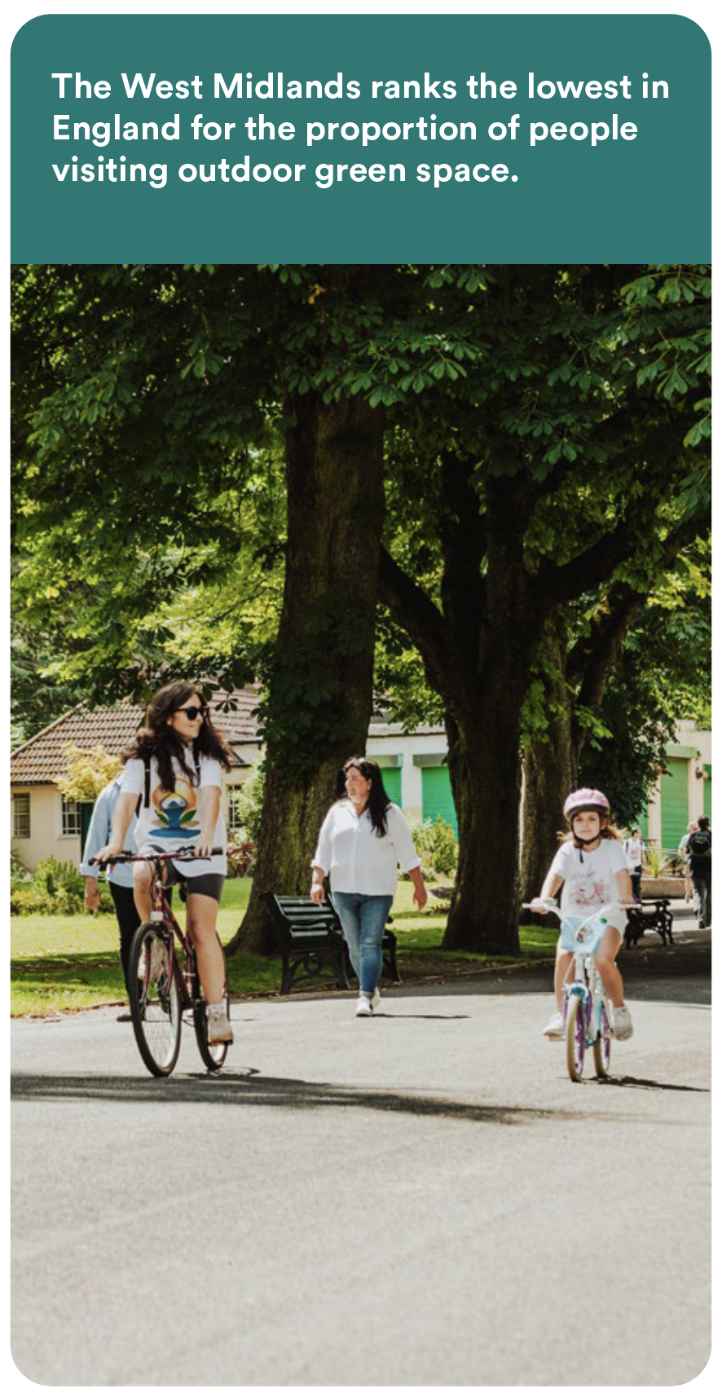
Regional challenges and opportunities
The WMCA area is predominantly urban with a fragmented and limited land bank. There is currently a lack of effective mechanisms/markets to drive investment into the type of green and blue infrastructure that the majority of the WMCA area requires.
Private sector finance is predominantly focused on landscape-scale projects that can offer £multi-million investment propositions. The WMCA area does not have individual natural capital projects of this magnitude. Aggregation mechanisms are needed to provide an investment offer of sufficient scale to attract and de-risk investment.
Current levels of public spending are failing to halt ecosystem degradation and biodiversity decline. Whilst Local Nature Recovery Strategies will provide a spatial framework and priorities to reverse this decline, the funding gap to deliver the UK’s nature-related targets is at least £6 billion annually.
There is a lack of evidence of what works, and a “missing middle” between local markets and national finance and supply chains. Addressing this gap requires place-based delivery frameworks and market infrastructure of a strategic scale.
Nature markets remain constrained by uncertainty and inconsistency. Finance models for Biodiversity Net Gain (BNG) are emerging and an opportunity exists for collaboration across local authorities.
There is currently insufficient local capability and capacity to leverage the full potential of emerging nature markets. The WMCA LINC programme has secured specialist support to develop regional capability.
The Green Infrastructure Framework for England provides standards for improving access to green space and urban nature recovery. There is significant opportunity to align Local Nature Recovery Strategies with the Green Infrastructure Framework and utilise LINC as the mechanism to unlock finance to deliver and maintain high quality green and blue space.
19

Slide 20
LINC programme schematic
1
Business Case Development
2
Developing the market infrastructure
3
Operationalising investment & funding facilities
Market research: supply and demand
Biodiversity Net Gain
Information frameworks
Investment/funding pathways
Maturity assessment
Impact / benefits realisation
Standardises impact metrics
Project screening criteria
Monitoring, reporting and verification requirements
Dashboard analysis
West Midlands Nature Investment Hub
Impact investment
Corporate sponsorship
ESG/CSR donations
Ecosystem service purchases
Grants
Natural Flood Management
Environmental data and natural capital baseline
Urban green & blue infrastructure
Economic analysis of ecosystem services
Health, wellbeing & recreation
Project data collection and analysis
Carbon sequestration
Regional BNG habitat bank SPV
Investment & funding opportunities & priorities
Urban cooling
Nature recovery: LNRS
Local Plans & Strategies e.g. LNRS
Skills, Jobs, Volunteering
Options assessment: governance & operating models
Accelerator pilot projects
Annual Impact Studies & Reports
Stakeholder engagement, marketing activities, and community of practice
20

Slide 21




West Midlands natural capital investment priorities
Investment in the region’s £20 billion natural capital assets strengthens the green economy, driving sustainable and inclusive growth.
Deliver housing targets and 10% biodiversity uplift
Reduce reliance on public grants
Increase market confidence and capital flows
Improve market transparency and accessibility
Economic Impact
Investment in nature-based solutions strengthens the region’s resilience to climate change impacts and supports delivery of net zero targets.
Reduce flood risk
Provide urban cooling
Sequester carbon
Reduce socio-economic impacts of climate change
Climate and Net Zero
Social Impact
Investment in green and blue infrastructure delivers benefits for everyone in the region, addressing inequality and improving quality of life, health, and wellbeing.
Improve health and wellbeing
Improve accessible green space
Provide volunteering, training, and jobs
Improve air quality
Investment in nature recovery restores biodiversity, creating and connecting habitats, and protecting our ecosystems for a nature-positive future.
Deliver the Local Nature Recovery Strategy
Restore and enhance habitats
Protect species and increase biodiversity
Improve connectivity for nature and people
Environmental Impact
21

Slide 22







LINC phase 1 outputs
Phase 1 of the Defra funded LINC programme has focused on developing the following outputs:
Market research reporting
Stakeholder engagement, surveys and interviews providing insights into regional demand and supply-side opportunities, and more.
Natural Capital Funding Framework
Collaborative framework outlining the rationale, strategy and roadmap to develop regional-scale market infrastructure for natural capital.
Natural capital economic assessment
Economic assessment of regional natural capital assets and ecosystem service provision.
Nature finance Community of Practice
Regional-scale community of practice, resource bank and interactive platform with 170+ members.
Analysis of operating models and roles Options assessment of potential market interventions, roles, operating models and governance structures.
Communication products
LINC film, brochure, web pages and case studies.
Accelerator 1: BNG
Accelerator programme for 6 local authorities delivering BNG investment readiness support and production of business case
Accelerator 2: Urban Greening Token
Accelerator programme to develop a minimum viable product to facilitate private sector funding for urban trees.
LINC
Natural capital pipeline
Pipeline framework, thematic pathways, metrics, project data dashboard, mapping, quality assurance and assessment criteria.
West Midlands Nature Investment Hub
Web-based impact marketplace providing single point of entry for investors, buyers and funders.
22

Slide 23
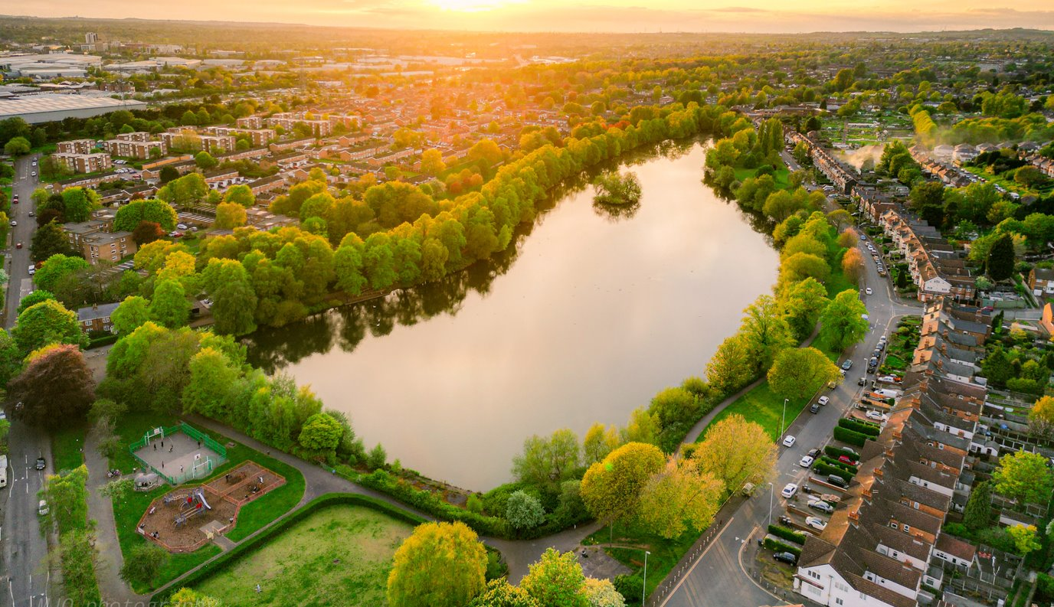
Evidence and market insights

Slide 24
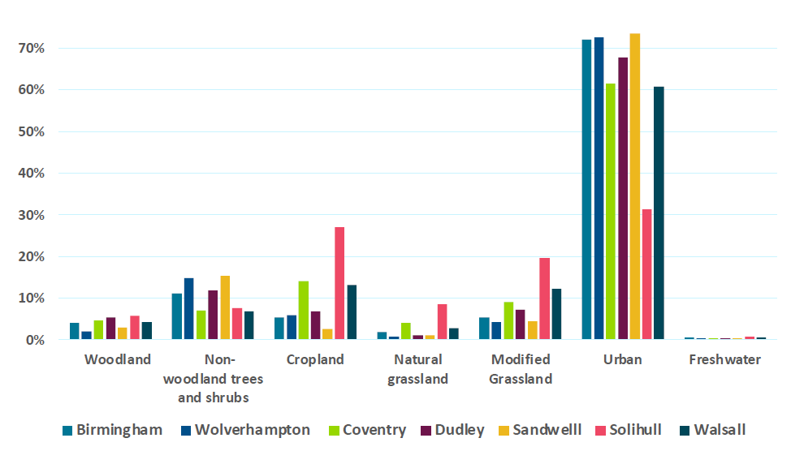
Natural capital accounting – baseline reporting
The Natural Capital Baseline Report was produced by eftec from available national and regional baseline datasets, and the ORVal tool (Exeter University).
The natural capital assets of the WMCA region are classified by broad land-use and habitat types. The total area is approximately 90,164 hectares, of which the predominant land cover type is urban. Consistent data for the whole WMCA study area was not readily available for this natural capital baseline account for some important assets.
With no single source of habitat data available for the WMCA, the asset register is derived from several publicly available data sources. All habitat data other than that for woodland and non-woodland land cover, was sourced from the Natural Environment Valuation Tool (NEVO) (University of Exeter, 2019). The urban area was then adjusted to take account of the differences in woodland and nonwoodland extent from the Centre for Ecology and Hydrology (CEH) and iTree (see the Natural Capital Baseline Report for details).
Percentage of land cover of each type by local authority in the WMCA study area
24

Slide 25
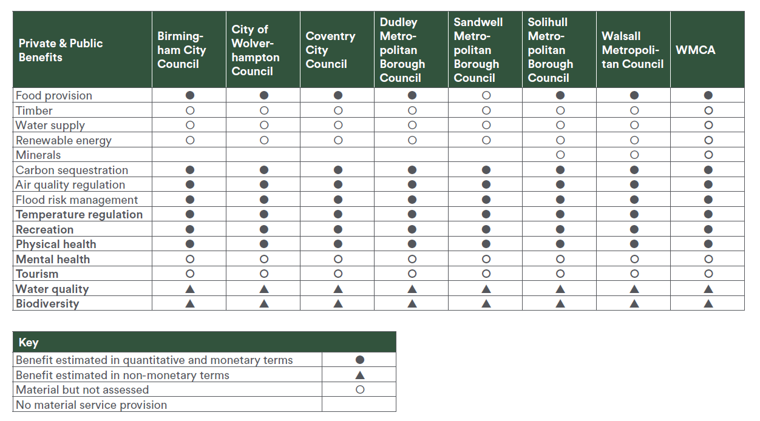
Natural capital accounting – baseline reporting
Materiality matrix showing the ecosystem benefits in each local authority in the WMCA region and the extent to which they were assessed for the baseline account
25

Slide 26
Natural capital accounting – baseline reporting (NCA)
The economic assessment of ecosystem services
The report employs DEFRA’s Enabling a Natural Capital Approach (ENCA) guidance and aligns to HM Treasury (HMT) Green Book required methods to value ecosystem service benefits of existing natural assets in the West Midlands. Monetary values have been inflated using HM Treasury deflators to 2024 price year (H.M. Treasury, 2024). The asset values are separated into private benefits to businesses and benefits to wider society. Asset values are calculated by summing the expected future annual flow of benefits over 60 years, discounted according to HM Treasury Green Book Guidance (2020) to express in present value terms.
The baseline assesses a range of benefits, covering provisioning, regulating and cultural ecosystem services provided by natural capital to people in the WMCA area. Those ecosystem services which can currently be measured and monetised can potentially provide benefits with a present value⁽¹⁾ of £21bn over the next 60 years. As not all benefits can be measures and valued, the total value of ecosystem services provided by the natural capital assets in the WMCA area will be significantly higher than this figure.
Natural capital valuations are summarised in the Balance Sheet (see the Natural Capital Baseline Report) across those ecosystem service benefits that can be appropriately valued. Other benefits without monetary value (e.g. species diversity and mental health) are not shown. While a range of benefits are identified, the report demonstrates that the greatest benefits from nature are those to people, with significant benefits to health and wellbeing, reflecting the acute value of nature in the urban environment.
Annual value of ecosystem services provided by natural capital in the WMCA geography
£401 million​ - annual recreation value of natural capital
£32 million - annual value of air quality regulation by trees
£2 million​ - annual value of flood reduction from trees
£200 million​ - annual avoided medical treatment costs
£18.4 million - annual value of carbon sequestration
£14.4 million - annual value of urban cooling from green infrastructure
26
1) Present value reflect the current value of an expected future flow of benefits and use discount rates to account for time preferences as the uncertainties of future benefit flows. A lower discount rate, as used for environmental benefit flows, places a greater value of benefits to future generations. The standard discount rate prescribed by HM Treasury Green Book is 3.5% for the years 0-30 and 3.0% for years 31-75 and is used for all benefits except air pollution and physical health. These use the health

Slide 27
Market Research: key objectives
As the LINC programme developed, market research at a regional scale coalesced into two broad areas – supply side engagement and demand side engagement. Supply-side activities focused on developing a pipeline of natural capital projects, whilst demand-side activities focused on understanding the market drivers and ecosystem services required by investors, buyers, and funders. Extensive engagement via over 100 workshops, activities, and events has established the foundations for defining our objectives, strategy and outputs.
Supply side engagement objectives
Demand side engagement objectives
Inform potential supply side stakeholders of the LINC project
Identify and gather information about potential projects for the natural capital pipeline
Engage to assess investment readiness and project needs
Understand the current state of engagement with buyer types, and any previous demand that has been identified
Shortlist projects for additional accelerator support and funding
Provide feedback to supply side stakeholders not selected for the accelerator funding to support pipeline development
Collaborate with market participants to understand the current interest/ type of engagement with funding nature
Understand the level of demand for ecosystem services, as evaluated against the natural capital pipeline (e.g. carbon credits)
Understand key barriers to funding / financing delivery of projects, and mitigants to increase funding flow
Increase awareness of how projects in the pipeline could deliver ecosystem service benefits / social outcomes to meet needs/ priorities of demand side actors
Build relationships between buyers and supply-side actors to support local funding ecosystem connectivity
Map range of qualitative and quantitative factors that affect interest in deploying funding (e.g. narrative, scale)
27

Slide 28
Market insights
Supply Side Insights
Demand Side Insights
In person engagement with project owners has been invaluable for increasing their understanding and capacity to engage with nature finance
The capacity that currently exists within local authorities limits what can be delivered despite ambitions/targets
A vast range of projects exist in the pipeline that achieve different outcomes and could be attractive to different sorts of demand-side stakeholders
Many opportunities exist for collaboration based on location, activity or outcome, which would drive learning/co-development
Many opportunities exist for aggregation of smaller projects that are too small to receive funding as a nature finance project alone
An interface with buyers is needed, allowing stakeholders to understand what buyers are looking for, and for buyers to understand the criticality of projects
Often funding is needed to help projects become investment ready – to gather appropriate data etc. as part of the feasibility stage
There are many opportunities for research and education in nature projects, and enthusiasm from research and education institutions to work in partnership
Surveys have proven a poor engagement method for such a nascent market – 1-1 engagement has been more productive
Buyers are positive about LINC ambitions for increasing funding for nature, increasing transparency and allowing funders to find projects and vice versa
Strong appreciation of WMCA LINC's approach to develop market and pipeline before seeking capital
Ticket size of £10k-£100k is particularly attractive. Limited larger cases
Hyper-locality to corporate offices/client projects/development is a key draw, as is specific narrative
Corporates need to identify suitable projects for CSR budget, often at short notice or with limited resource
Projects with a strong social value element (which can be easily assessed/monitored as such against reporting frameworks) are particularly valuable for larger corporates
The concepts and rationale for accelerator models are easily understood
There is some appetite for Urban Greening Innovator and a clear understanding of ‘trees as a service’ that can be funded directly
Keen interest in aggregator vehicles and regional BNG SPV model. Lenders indicated that a BNG loan still needs to be supported with security over another asset. BNG SPV considered only an “investible” model (at this stage) by lenders.
28

Slide 29
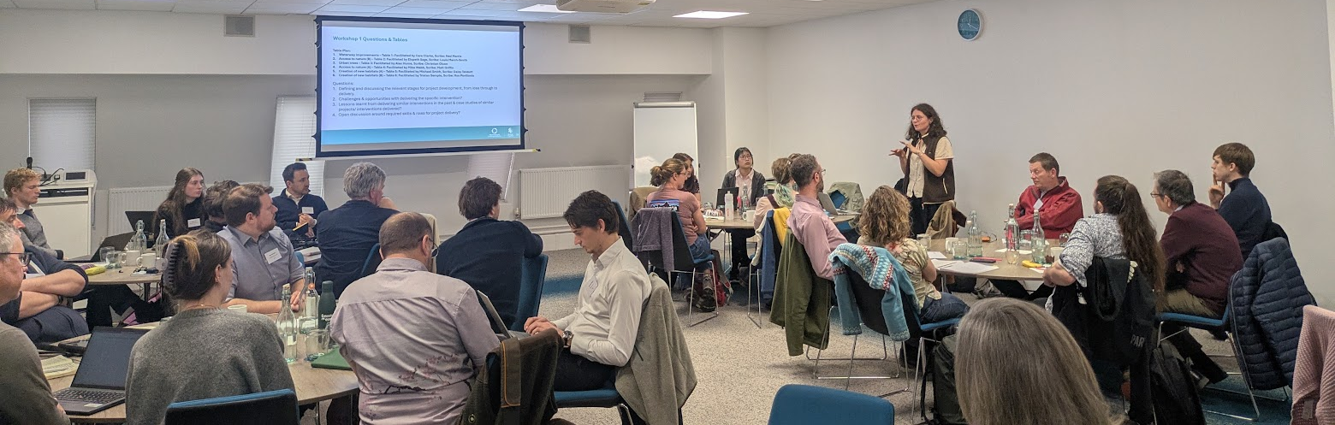
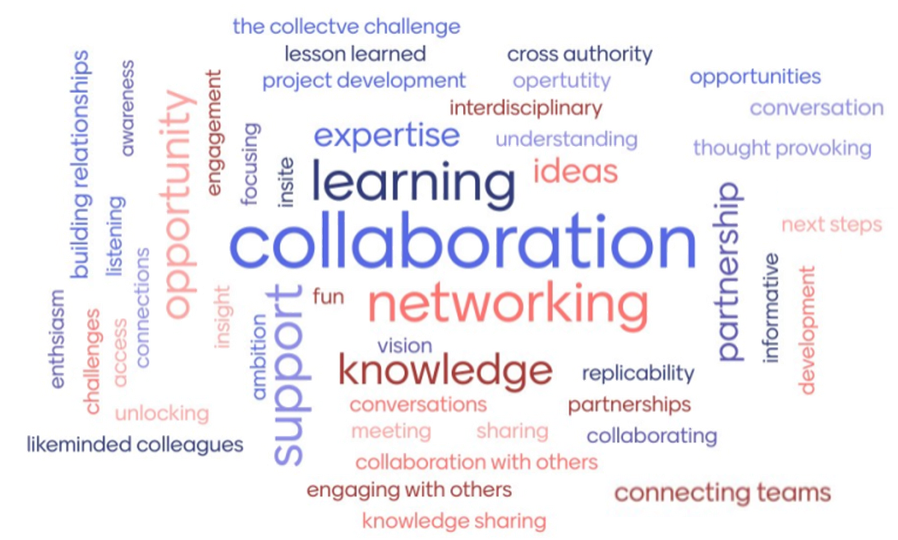
Supply side engagement
78
Number of organisations engaged with
233
Number of individuals engaged with
Activities
Supply-side engagement included events, webinars, and group workshops to deepen our understanding of each project delivery organisation’s strategic objectives, challenges, and project opportunities
Project owners submitted a long list of projects through 4 successive gateway phases. These projects were mapped to the Green Finance Institutes Investment Readiness Milestones to identify what support was needed
To transition projects into and through the natural capital pipeline, a pipeline framework and guidance documents were produced. These resources were supported with tailored 1-2-1 workshops to draw out sufficient information to get a tranche of projects ready to be advertised on the market-facing platform, connecting them with buyers and funders
A Basecamp site has been established as an online natural capital Community of Practice (CoP) for the West Midlands, with over 170 members
29

Slide 30
Demand-side engagement: Key findings
A total of 251 demand-side organisations were engaged through events and surveys. 40 demand-side organisations were also engaged with through 1:1 meetings. Findings include:
Headline findings and feedback from demand-side organisations
There is interest in business impact on the natural environment, predominantly driven by company mission and customer demand (and to a lesser extent by financial resilience), but this trails explicit net zero activity. Possibly because of this, the most interesting natural capital projects to businesses are nature-based solutions for climate change.
There is low engagement in nature markets or funding natural capital projects directly, due to lack of awareness and lack of capacity.
Sustainability is losing prominence in organisational strategy unless it is explicitly linked to economic and productivity outcomes. The feedback suggests natural capital needs to be clearly tied to workforce productivity, health system pressures, and inclusive growth, rather than being positioned as a stand-alone environmental concern.
Lack of regulation is cited as a reason for non-engagement in nature markets, with limited demand drivers and understanding of benefits. Corporates also report that national policy messaging is fragmented, generating confusion and market uncertainty.
The hyper-locality of nature improvement projects is stated as particularly persuasive to build management buy-in.
There are structural limitations in terms of the corporate landscape in the region. The region is dominated by subsidiaries or satellite offices, meaning it is harder to secure buy-in or anchor large-scale private sector investment for localised nature-based initiatives.
Corporates are increasingly aware of ecosystem services and natural capital due to CSR requirements, but the internal importance of these factors beyond compliance is still uncertain.
The business case to fund publicly accessible green space is uncompelling and lacks evidence. Paying for flood mitigation or environmental improvements on their own land for employees is a far higher priority.
Where corporates have expressed an interest in supporting local projects with social and environmental impacts, unlocking investment depends on a clear and measurable social value proposition. They want to see a calculation or framework that quantifies social return on investment, including volunteering hours, community benefits, and outcomes for local people.
30

Slide 31
Lack of relevant funders and investors
Market engagement has revealed that there are a lack of relevant funders and investors that can provide funding (especially repayable capital) for urban nature restoration locally due to the small scale of projects and the lack of developed urban nature markets with investible propositions.
Baseline / core (Integral)
CSR payments
Public grants
Payments for Ecosystem services (PES)
Non-repayable capital
Impact investors
Relevance to natural capital investment facilities
Enterprise revenue
Potential local/climate levies
Specific Relevance (Targeted)
Institutional investors
Repayable capital
Trusts and Foundations
Revenue/ income
Wider ecosystem (Opportunistic)
£1m
£10m
£100m
Scale of relevant funding (£/yr)
FE and WMCA completed a detailed market mapping of funder types and funding streams
31

Slide 32
Availability of funding is limited across nature markets
Across the key urban nature markets, overall funding is limited and the available funding is concentrated in public/philanthropic grants.
Biodiversity units/ credits
Potential buyer(s):
Project developers
Corporates
Potential buyer(s):
Governments
Corporates (CSR)
Community groups
Urban greening (and benefits, e.g. air quality)
0 1 2 3 4
0 1 2 3 4
Carbon credits
Potential buyer(s):
Corporates
Supply chain off-takers
SuDS and water quality
Potential buyer(s):
Water Utilities
Insurance companies
Corporates
0 1 2 3 4
0 1 2 3 4
Potential buyer(s):
Businesses
Consumers
Health/social prescribing
Potential buyer(s):
Governments
Foundations (private/ corporate)
Ecotourism and green enterprise
0 1 2 3 4
0 1 2 3 4
Philanthropic contributions
Repayable capital
Public grants
0 – No funding available.
1 – Limited funding available.
2 – Some/medium funding available.
3 – High amount of funding available.
4 – Very high amount of funding available.
32

Slide 33
Recommendations for next steps
Supply side recommendations
Demand side recommendations
Need for political/senior management support for local authority projects – this is an important next step for stakeholder engagement
Supply side organisations are materially undercapacity and need significant additional resource to generate meaningful projects, data and scale
Collaboration and centralisation could help overcome major barriers
At risk / early-stage funding is difficult to unlock to move projects beyond high level concept phase
Opportunities for more strategic events targeted at senior leadership to get ‘buy-in’ for the LINC project, rather than environmental managers having to make the case without understanding the full picture
In person discussions have proved critical for understanding the nuances and value these projects bring, and such engagement should continue as projects develop
Project owners are often the best to ‘sell’ their project
Regional demand to fund impactful projects is meaningful but quantification and transparency are key drivers
Beyond BNG, specific demand for ecosystem services is limited due to weak demand drivers. Some interest in carbon but limited pipeline in the urban setting
Lack of pressure from local or regional government to formalise demand beyond CSR for impact projects
Political leadership could build a clear case for corporates coalescing around a strategy for regional nature, including buyer groups
Corporates willing to enter more structured partnerships to unlock projects should be facilitated
Recommendation: sandboxing
The lack of investible ecosystem service markets in the West Midlands was clearly linked to a lack of demand drivers. Corporates recognise benefits of nature but due to attribution/measurement challenges it is difficult to unlock funding. There is a strong case for WMCA sandboxing new drivers to increase engagement with ecosystem services. This would focus on ecosystem services with the greatest tangible economic benefits. One example would be a water management model (e.g. flood resilience).
33

Slide 34
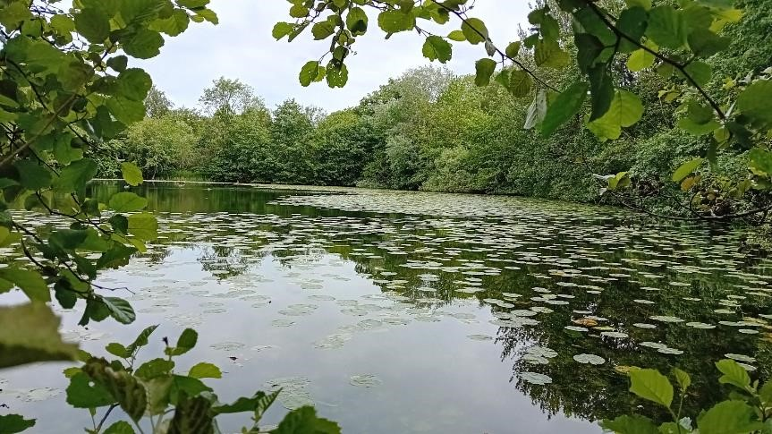
A regional-scale project pipeline

Slide 35
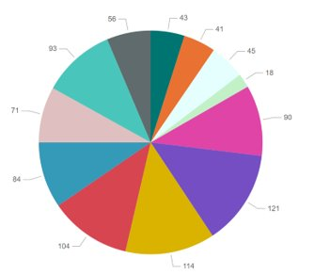
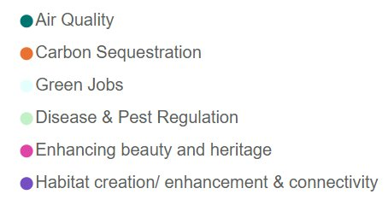
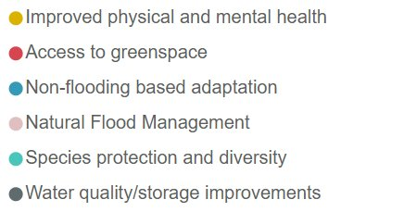
Pipeline development
Pipeline projects and ecosystem services
The programme adopted a phased approach to building a regional scale pipeline of natural capital projects, recognising the complexity of aligning multiple stakeholders, geographies, and delivery mechanisms. Over the course of more than 100 targeted events and workshops, the initiative has brought together public bodies, charities, utilities, land managers, investors, local businesses, community organisations, and technical experts to co-design a coherent project pipeline.
The approach is intentionally incremental. Early phases focus on engagement, shared understanding, and foundational capability; establishing common language, baseline data, and governance principles. Subsequent phases introduced increasing levels of technical, financial, and operational complexity, including standardised project development frameworks, prioritisation tools, investment-readiness criteria, and delivery pathways. Each phase builds on the learning, relationships, and systems established previously, ensuring that complexity is introduced only when stakeholders are ready to adopt it.
By structuring delivery in this way, the programme has reduced risks and supported capacity-building across the region. The process has been focused on embedding lessons learnt through an iterative approach to create a scalable pipeline system that can evolve over time. The result is a durable regional framework that enables the identification, development, and mobilisation of natural capital projects at scale, while remaining responsive to local contexts and stakeholder needs.
35

Slide 36
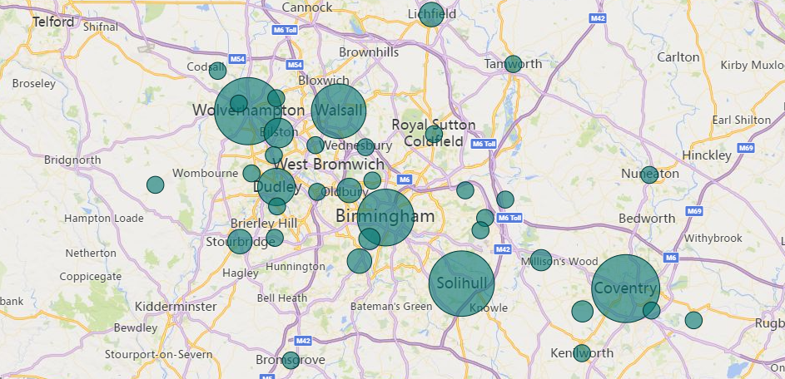
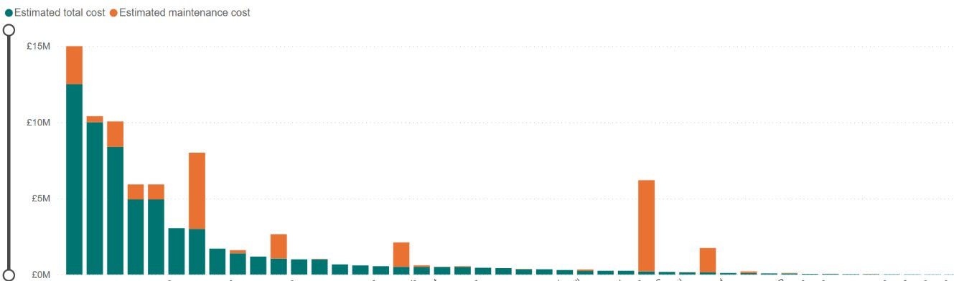
Natural capital pipeline
Distribution of projects across the West Midlands area
The natural capital pipeline consists of a range of projects submitted to the WMCA via the LINC Programme. It is a critical part of the programme and encompasses over 200 natural capital projects (e.g., blue and green infrastructure, nature-based solutions, habitat creation and enhancement).
A key focus of the pipeline is to provide opportunities to aggregate outcomes at a regional scale. This helps to increase the investment proposition and strengthen opportunities for blended finance. Suitable projects that have been identified have received support to increase opportunities to leverage private sector investment and funding.
The pipeline categorises and provides analysis opportunities to break down the different interventions, outcomes, ecosystem services and other features of each of the projects. Projects were reviewed to understand their current and future potential to attract repayable investment. Projects that are viable for private finance were identified and shortlisted for development through accelerators to help attract funding.
The majority of projects are less viable for current nature markets but still deliver valuable environmental, social and economic benefits. These projects will rely more heavily on philanthropic, public or blended finance to deliver their outcomes, but are still captured within the natural capital pipeline.
Projects that are at a suitable stage of maturity within the pipeline will transition to a market-facing platform. The analysis of these projects is captured in an interactive dashboard, to identify key themes. This pipeline can be considered as a current reflection of projects that are being developed by major natural capital stakeholders in the region.
Project delivery costs in £millions
36

Slide 37
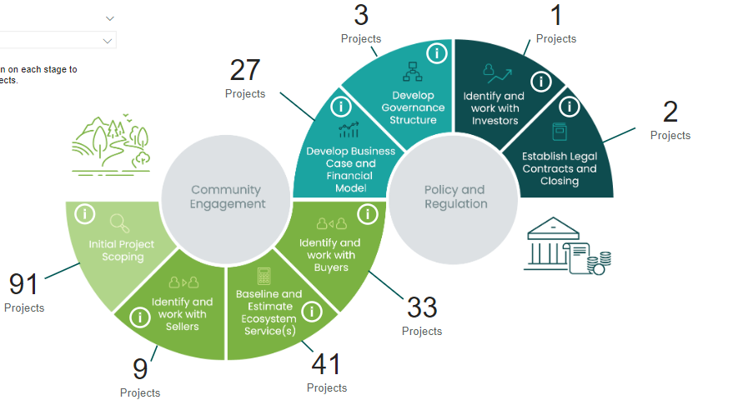

Investment Readiness Journey
To support the development journey for projects, pipeline frameworks have been created to provide structured resource and guidance to help projects mature
and prepare towards investment / funding readiness. The Green Finance Institute’s Investment Readiness Toolkit was utilised to support stakeholders in assessing their project maturity and next steps.
207 projects gave some information about project development / maturity. However, we were able to estimate the stage for all 211.
Nearly half of the projects are at initial scoping / concept stage, with very few projects ready for delivery.
Project timescales vary significantly across the pipeline.
The ratio remains roughly the same when accounting for projects that are viable for mature ecosystem service markets.
Evaluating ecosystem service benefits and financial modelling are common barriesr to progression.
37

Slide 38





Pipeline challenges
Urban context with fragmented land bank
The WMCA is an urban conurbation, so does not have large blocks of rural land for creating woodland (e.g. for carbon markets) or BNG habitat banks. Nature interventions and projects are often small-scale and need to work within an urban setting, which tends to lead to greater social impacts than environmental.
Competing priorities for land use
Making the business case for natural capital interventions is more complex when up against limited space for development and other critical priorities for the region, often leaving natural capital to small areas where little scale can be leveraged. Trees for example in urban setting can be viewed as both an asset and a risk.
Unsuitability of projects for nature markets
Two-fold, immaturity of nature markets to value urban habitats at a small scale, and unsuitability of projects to align with current more established nature markets (carbon sequestration, biodiversity net gain) given scale and habitat type.
Multi-disciplinary teams and matrix decision making
Green infrastructure in a heavily urbanised region is rarely considered in isolation, it is primarily a smaller, sub-category of wider infrastructure, development, and place-making decisions. Establishing natural capital as a priority asset class to invest in is challenging given the complexity of competing priorities and regional decision-making processes.
Multiple project outcomes and metrics
Projects are delivering multiple ecosystem services which we all benefit from, but few have an established market. Measuring these benefits can be costly and difficult, which presents challenges in developing business cases.
Project costings and ecosystem accounting
Projects owners struggle to quantify the value of natural capital uplift, delivery costs, and long-term maintenance. There is a skills gap multiplied by the challenges in identifying which of the many ecosystem accounting tools/ methodologies to use.
Lack of resource capacity/capability
Project owners in some instances are struggling to engage fully with LINC because of their day-to-day job. In time, LINC presents an opportunity for funding, and that means more resource which can address capacity issues, but there is a time-lag before this benefit is realised.
38
Notes:
Template

Slide 39
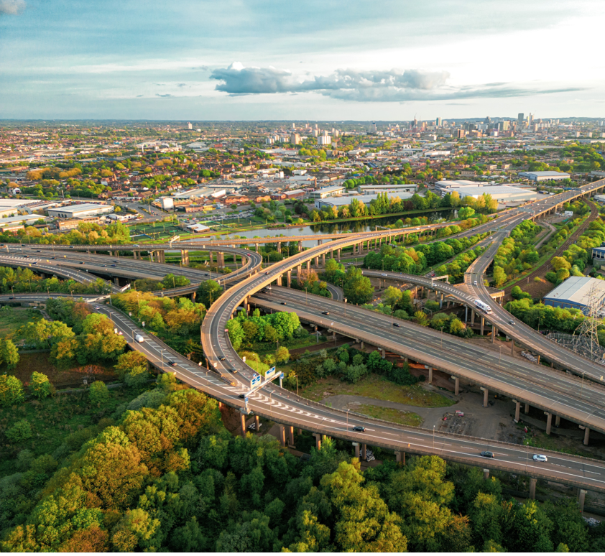
The West Midlands Nature Investment Hub

Slide 40
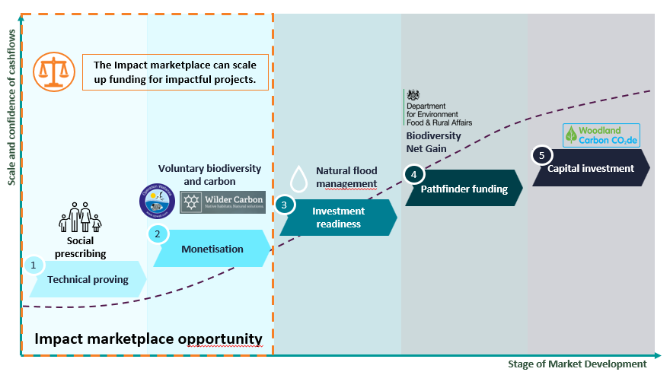
We are building a new economy—powered by nature.
The West Midlands Combined Authority is working to deliver a greener, fairer, and more prosperous region. Our Inclusive Growth Framework calls for a new kind of economic model—one that places social and environmental outcomes at its heart.
Our Local Investment in Natural Capital (LINC) programme is a nationally supported trailblazer, funded by Defra to test how local areas can unlock private and blended finance to support nature recovery and climate action. This programmes allows us to re-connect nature with economic planning as a driver of our economic future and not a barrier to growth. Through LINC, we are creating the infrastructure to support a thriving funding ecosystem for nature at a regional scale.
Our mission is to create a regional funding ecosystem capable of scaling investment in green infrastructure, improving health outcomes and climate resilience, and delivering the region’s Local Nature Recovery Strategy. We aim to position the West Midlands as a national leader in urban nature finance and a model for how places can achieve inclusive, sustainable growth through investment in natural capital.
The West Midlands Nature Investment Hub, as a digital platform will:
Connect investors, funders, and project delivery organisations.
Provide robust, transparent, and collaborative governance.
Support regional capacity building and knowledge exchange.
Provide in-depth project screening for quality assurance.
Assess trusted delivery partners against established criteria.
Produce annual impact reports across all projects.
Measure delivery against LNRS priority actions.
Provide marketing activities to increase funding opportunities.
Allow buyers and funders to easily identify and compare projects.
Act as a single front door for the region’s natural capital.
Standardise metrics and approaches to reporting.
Provide technical support to transition stakeholder projects to investment readiness.
40

Slide 41
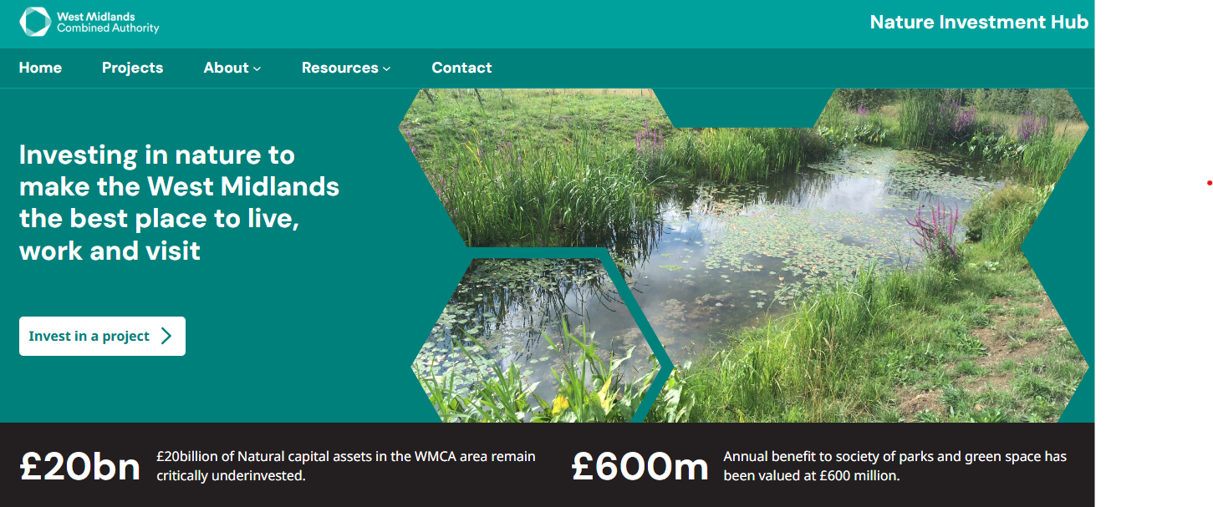
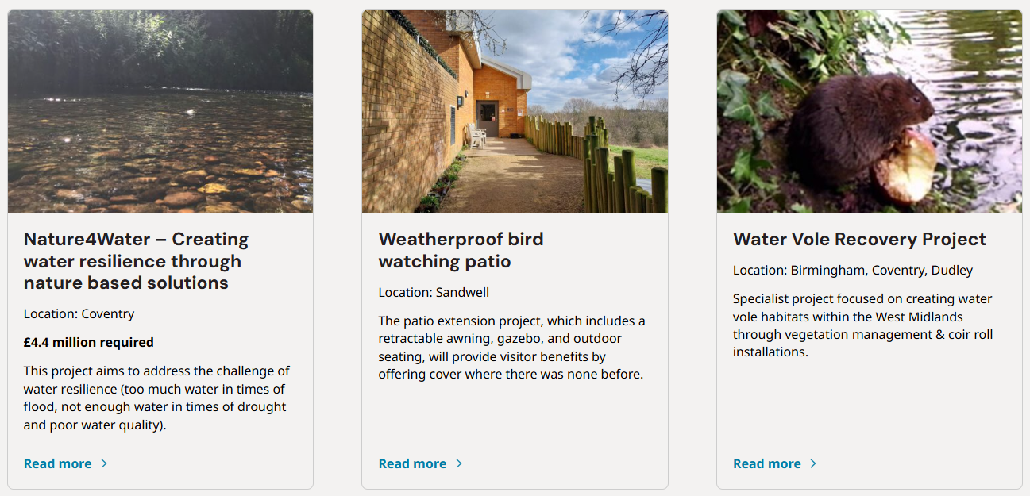
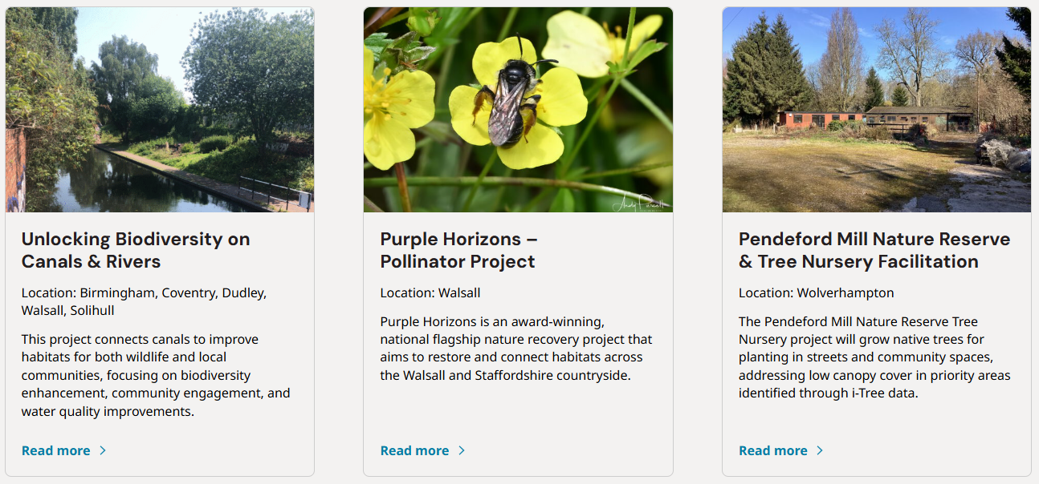
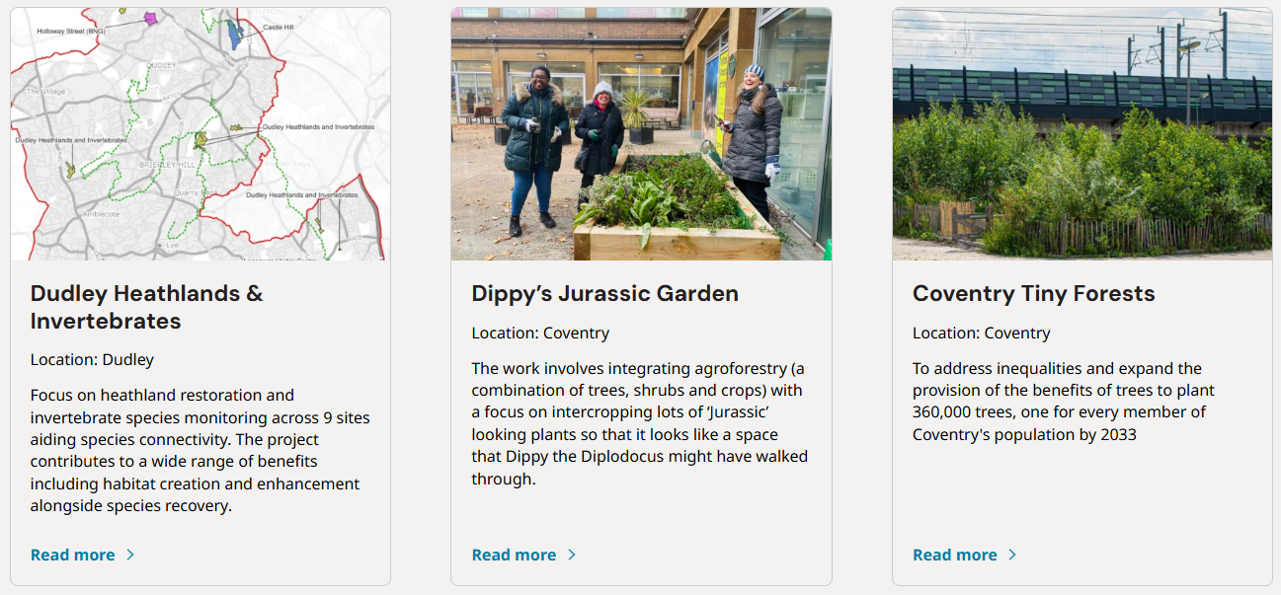
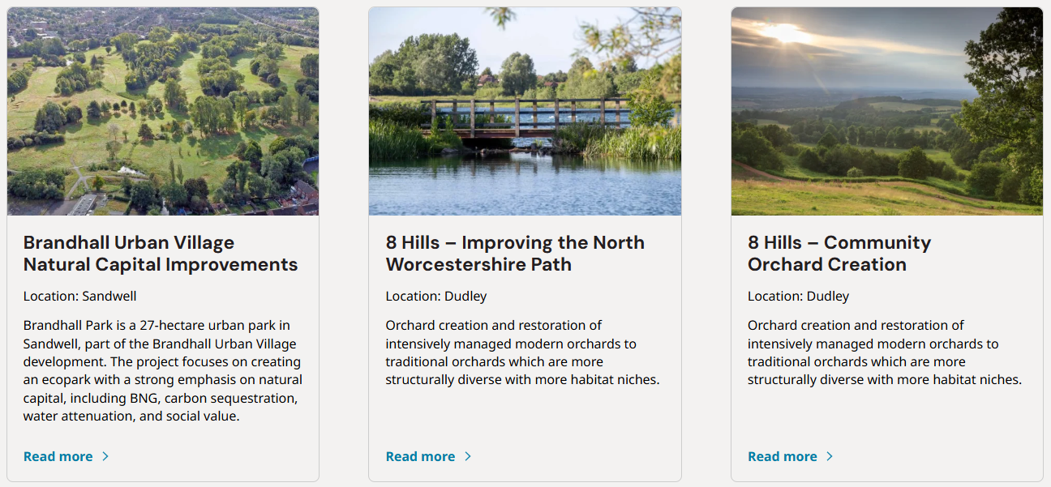
Nature Investment Hub
70-80% of projects in the regional pipeline do not have a clear route to existing unit-based nature markets. In addition, few projects have identified viable revenue generating opportunities. Most projects are therefore ineligible for investment in the form of repayable finance.
To address this challenge, the Nature Investment Hub will initially focus on securing funding from regional SME’s and corporates for projects which can deliver measurable social and environmental impact. The focus here will be on Environmental, Social, Governance (ESG) frameworks and Corporate Social Responsibility (CSR). The “Hub” will expand to include BNG and sale of ecosystem services in 2027.
The Nature Investment Hub is an online, market-facing platform designed to accelerate investment in regional nature-based projects by connecting high-quality projects and their delivery organisations with public and private buyers, investors, and funders. Acting as a single, trusted front door, the Hub showcases a curated pipeline of “shovel-ready” projects, providing visibility, confidence, and transparency at a regional scale.
41

Slide 42
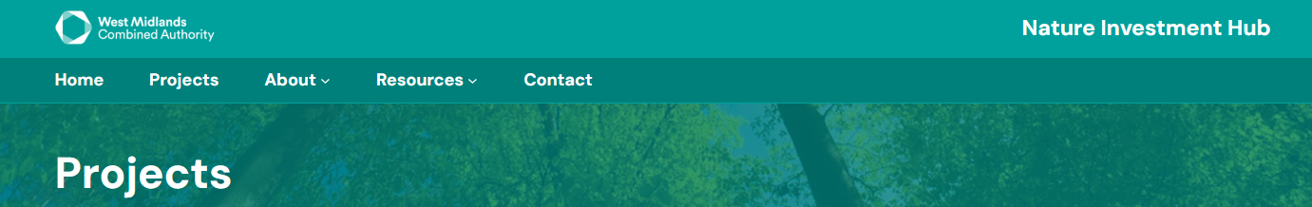
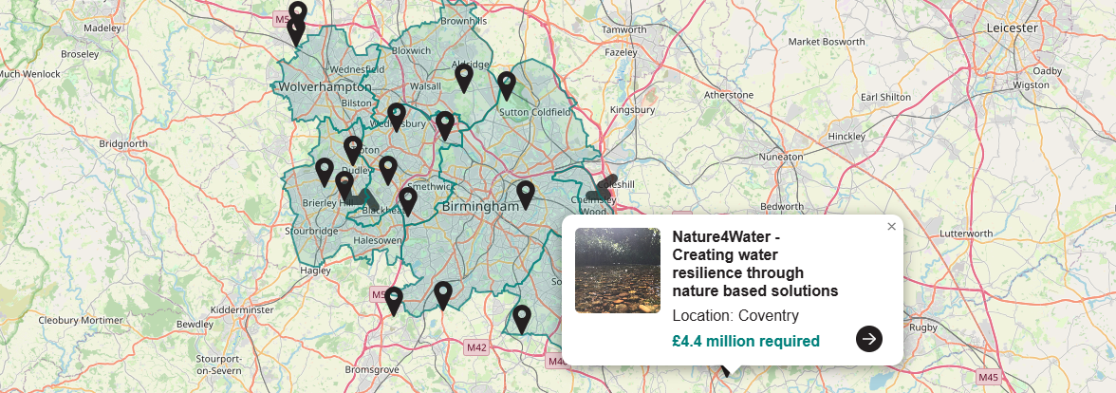
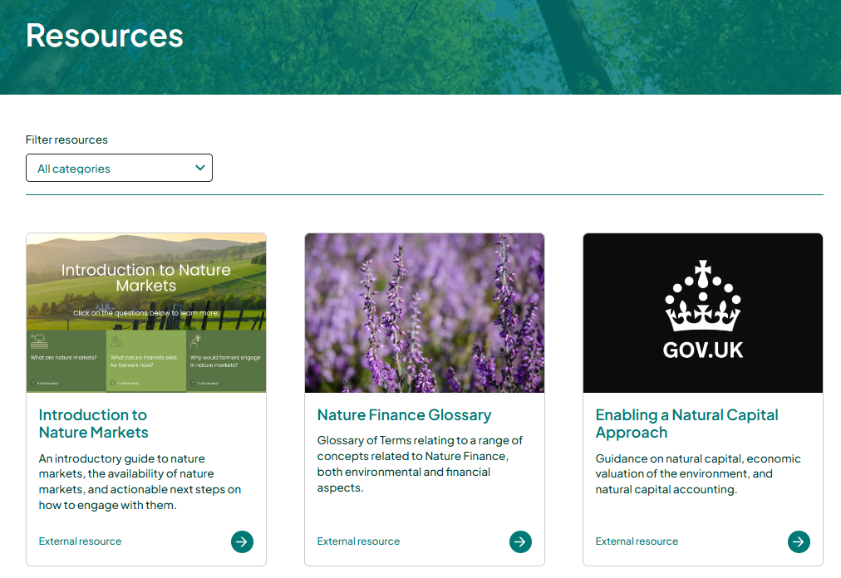
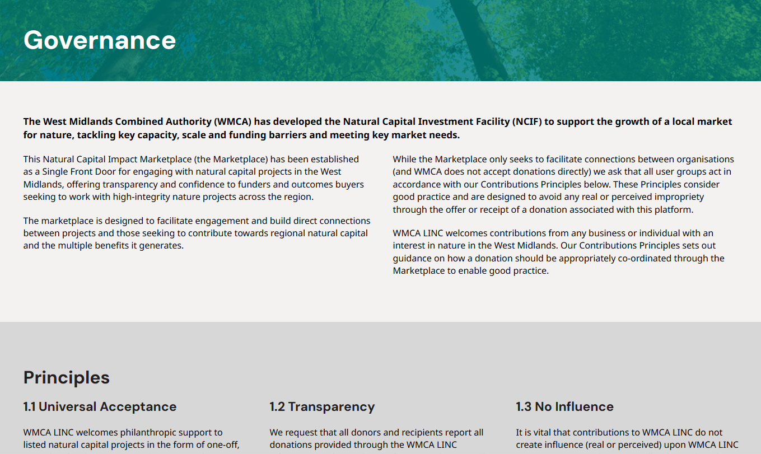
Nature Investment Hub
The Hub supports the development of a blended funding ecosystem by bringing together public-sector funding, private capital, and philanthropic investment—particularly for non-revenue-generating projects that deliver significant public and environmental value.
By increasing opportunities for match-funding and co-investment, the platform helps unlock finance that might otherwise remain inaccessible. For revenue-generating nature-based projects, the Hub enables access to markets for ecosystem services, such as Biodiversity Net Gain (BNG), supporting the sale and aggregation of verified environmental outcomes.
Through standardised metrics and consistent project screening, the Nature Investment Hub provides quality assurance and comparability across projects. This approach builds market confidence while allowing the platform to demonstrate the collective scale, impact, and replicability of regional projects using scalable operating models.
Annual impact reporting further strengthens transparency, enabling investors, policymakers, and communities to understand environmental, social, and economic outcomes over time. Beyond project visibility, the Hub acts as a central point for engagement and collaboration. It facilitates knowledge sharing, resources, and partnership opportunities between project developers, buyers, and funders.
42

Slide 43
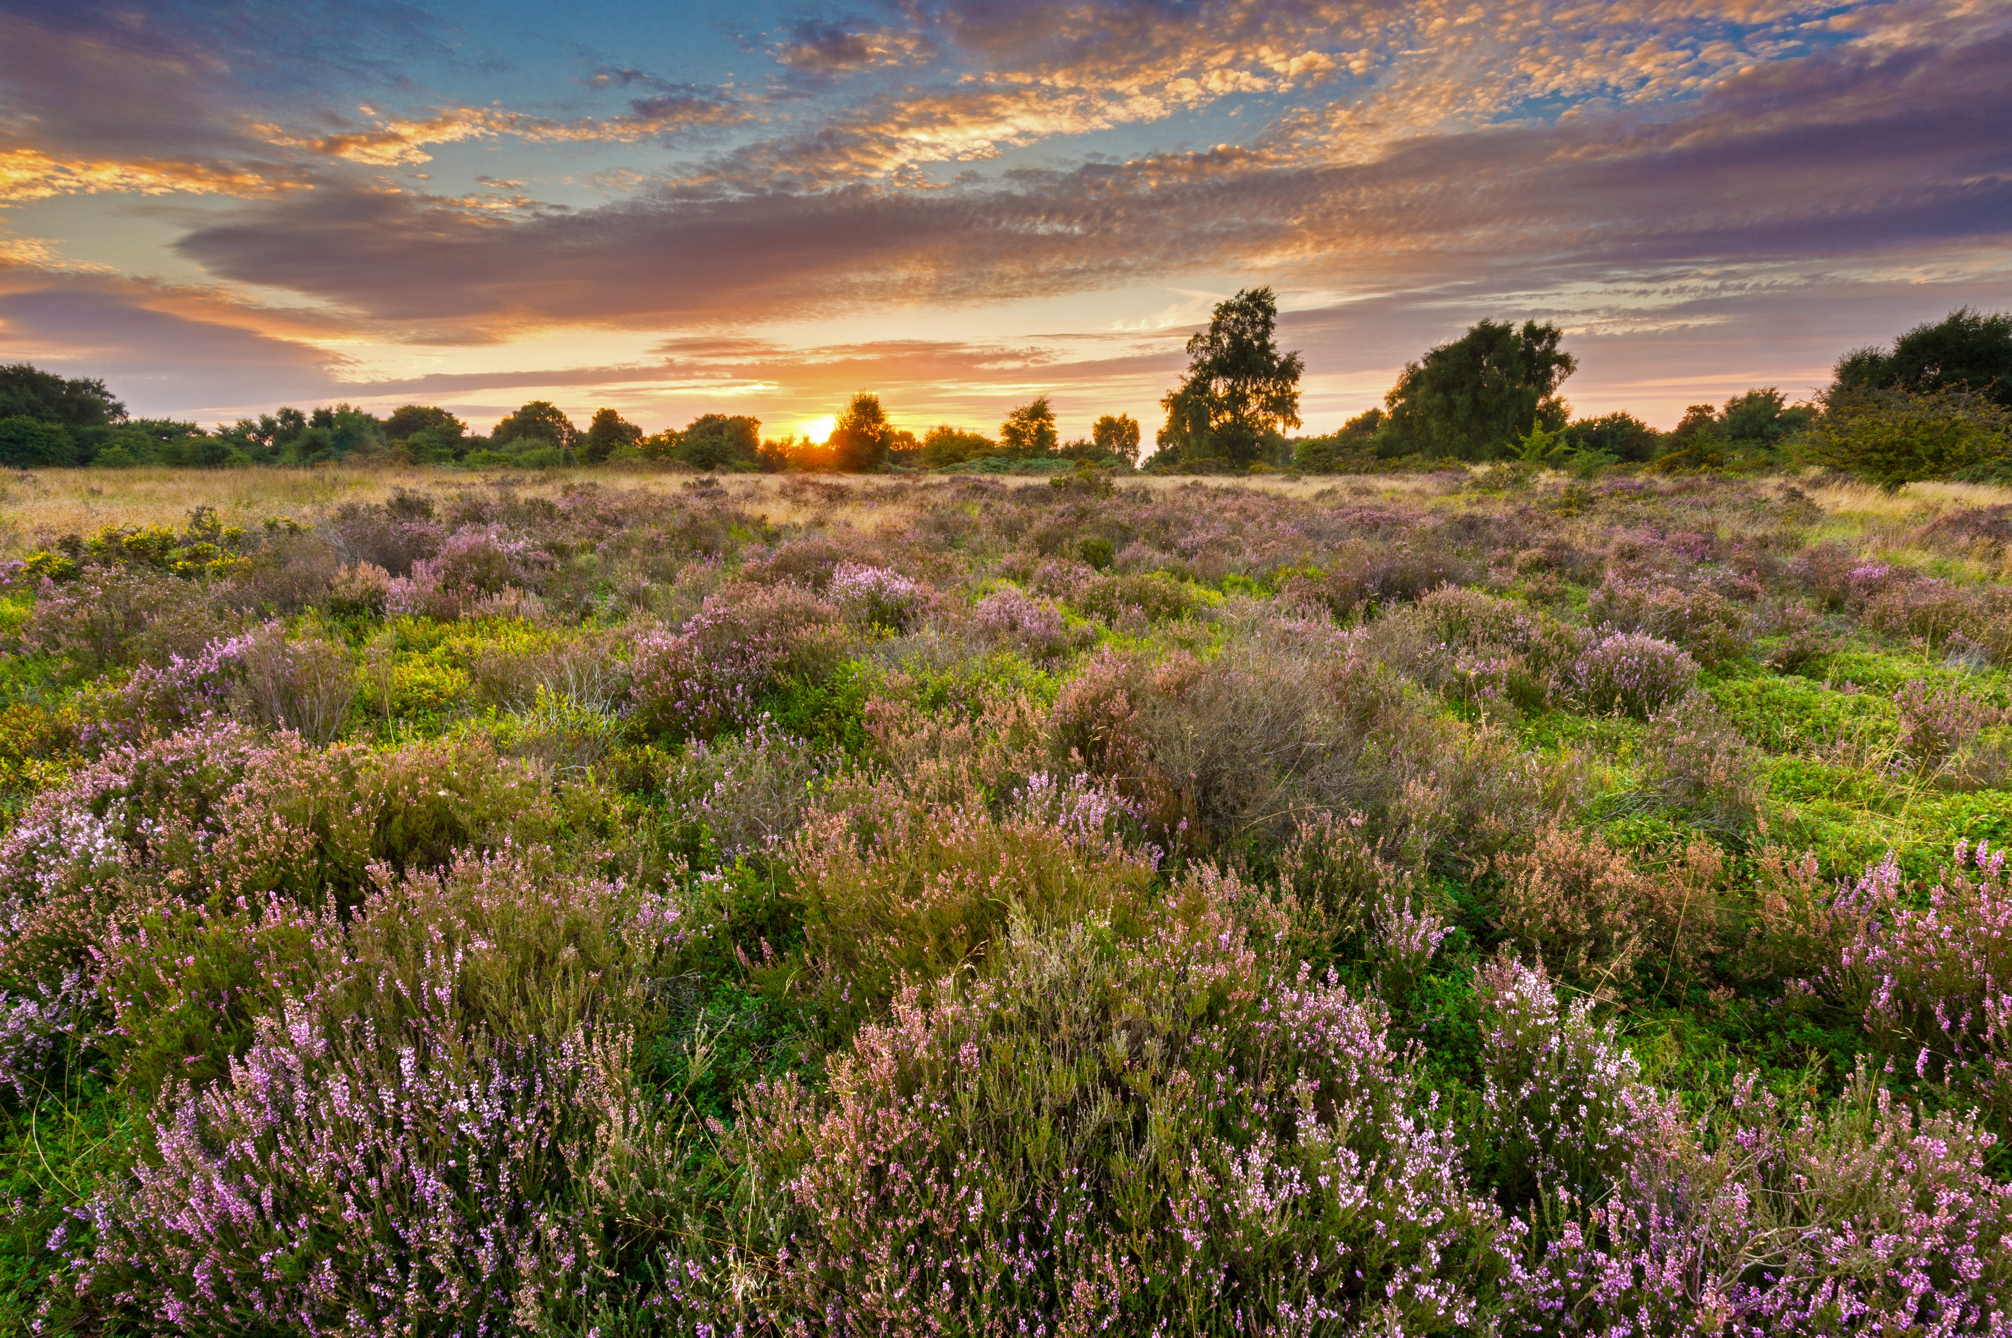
Accelerator programmes

Slide 44






Accelerator objectives
WMCA launched two Accelerator programmes during LINC focused on 1) Biodiversity Net Gain and 2) Urban Greening.
Selecting pilot projects and developing them across the investment readiness journey.
Supporting with the development of a proof-of-concept regional approach.
Training and supporting project developers with market mechanics.
Sharing learnings and key project templates with regional organisations.
Building a network of buyers, investors, beneficiaries, suppliers interested in market development.
Developing urban nature markets and underlying templates and standards.
44

Slide 45
Accelerator programme engagement activities
Biodiversity Net Gain accelerator and Urban Greening Innovator projects have been engaged through various community of practice sessions and structured workshops.
Key updates
7
Number of BNG accelerator pilot sites assessed across the West Midlands
Since the selection of the BNG Accelerator projects in October, there has been ongoing engagement with relevant stakeholders. This has included various workshops focused on:
  Fundamentals of BNG.
  Building an investment case.
  Modelling cashflows from individual projects.
  Governance and structuring.
1:1 sessions to provide additional guidance to LAs.
Financial assessment for the 7 pilot sites across 6 LAs. The financial modelling outputs have been shared.
An aggregated financial model and Feasibility Study for the regional BNG vehicle has been produced.
For the Urban Greening Innovator, our consultants worked with three LAs to identify planting opportunities at scale. All LAs have shown strong support for the potential of this model, in keeping with wider market actors interviewed.
13
Workshops and engagement sessions held with LAs through BNG accelerator
5
LAs engaging to support Urban Greening Innovator (with 1200 planting opportunities identified in Wolverhampton alone)
17
Market stakeholders engaged across both programmes
45

Slide 46




A regional approach to delivering Biodiversity Net Gain
Through the WMCA Biodiversity Net Gain accelerator, a feasibility study was conducted to assess the opportunities for a regional scale approach to delivering BNG to unlock housing development while delivering high-quality outcomes for nature. LINC phase 2 will transition the feasibility study to a full business case.
Overview
Key Estimated Benefits
WMCA LINC has provided targeted financial and technical advice to local authority teams to unlock BNG sites across the West Midlands through an Accelerator programme.
A range of sites have been prepared for BNG, totalling 187ha of priority enhancement, aligned to the Local Nature Recovery Strategy.
Combined, sites represent BNG delivery of 852 saleable Units, meeting 48% of regional demand to 2035.
£36m revenue and £15m profit over 30 years²
Significant savings for LA parks and green estate teams
Delivery of a market-leading approach
Options for governance and structuring have been assessed and will inform a business case.
A regional-scale approach to delivering BNG could provide key delivery efficiencies, consistency of supply and contracting, coherent nature recovery and confidence to developers in the quality of BNG uplift.
This work demonstrates the critical role of such Accelerator and Aggregator programmes to unlock investment in nature at scale.
187 ha of strategic nature recovery supported locally
Several social and health benefits from retained and enhanced urban greenspace
£4m investment for Council owned BNG delivery sites could generate £15m profit to fund non-revenue generating natural capital projects in the region.
46

Slide 47
Regional BNG Habitat Bank development process
Project overview
Market analysis
Financial summary
Governance structure
Risk register
Investment raising
Provides a high-level summary of key project information including:
Opportunity identification
Goal setting
Key project data
Key stakeholders and their roles
Feasibility testing
Provides an overview of the local market for BNG units:
Market sizing/demand
Planned/intended route to market
Expected local BNG unit supply*
Provides an overview of the financial viability analysis:
Key assumptions for costs and revenue
Proposed unit sales approach/timing
Full project cashflow model
Exit analysis
Provides an overview of the proposed legal structure, governance arrangements:
Key contracts
Financing considerations
Governance structure and key governance roles
Details of the legal entity and ownership
Enables the identification, assessment and management of potential risks that could impact the project’s objectives including:
Delivery risk
Market risk
Development risk
Need mapping
Assumptions soft testing
Market engagement
Investment options mapping
Early funder engagement
Investment marketing and initial commitment.
1
2
3-5
6+
47

Slide 48













Benefits of a regional BNG approach
General benefits of setting up SPVs
Benefits of a regional BNG SPV
Protects LPAs from financial/tax complexity and financing for exploratory models remain off balance sheet.
Distinct, purpose-built entity to facilitate green finance flows at the regional level.
Strategic alignment of BNG to delivery of the LNRS and other regional ambitions.
Allows LPAs to make profits from the sale of BNG units through the SPV route.
Flexibility in structure to allow further building as desired by partners.
Crowds in new and alternative forms of repayable and non-repayable capital that may not be available.
Significant economies of scale and reduction in cost/resource for LPAs.
Clearly ringfenced surpluses for re-investment into other ecosystem services projects.
Consistent approach on developer demand and pricing for the region (broadened market scope).
Reduce potential conflict of interests amongst the various broader roles that the LPAs play in the BNG market.
Potential to aggregate smaller sites and improve viability.
Generate a fixed income stream for 30+ years for LPA Green Estate teams
Shared learnings and general collaboration.
48

Slide 49
BNG site journey
The journey comprises three broad phases: the development, implementation and maintenance phases.
SPV = Special Purpose Vehicle
LPA = Local Planning Authority
Development phase
LPA identifies site for BNG
SPV supports with baseline survey and target
options
SPV supports with costings and financial viability
SPV and LPA assess preferred funding route
LPA takes the site to cabinet for approval
SPV and LPA advertise EOIs on the lease and sign agreement
SPV and LPA sign a S106 and MSA
SPV and LPA agree an HMMP for the site
Project Lifecycle
Implementation phase
Maintenance phase
SPV registers site⁽²⁾
LPA starts habitat restoration
SPV makes sales based on discussions with LPA⁽³⁾
SPV records unit sales
on the
register
SPV and LPA undertake management,
monitoring and reporting
Surpluses are shared and re-invested
+≥30 years
Adapted from DEFRA BNG flowchart for landowners: https://defraenvironment.blog.gov.uk/2023/11/15/biodiversity-net-gain-for-land-managers-step-by-step-flowcharts/
Registering the project on the Natural England habitat bank site register.
Based on a post-restoration sales approach.
49

Slide 50




Urban greening innovator: Challenge and opportunity
As identified through the pipeline process, nature market opportunities are typically oriented towards large-scale rural projects. These markets are often poorly suited to support small scale, urban projects, even where impact/benefits are clear. A nature market specifically for urban greening could unlock new funding for underserved critical green infrastructure in cities.
Urban green infrastructure (“UGI”) projects are small (usually 0.5 ha or less) and often contain interventions such as the addition of street trees, pocket parks, rain gardens and retention ponds.
Quantifying and attributing the impact of these projects is difficult, due to the typically qualitative and hard-to-measure benefits they produce. Low density of urban trees means benefits from CO₂ sequestration are minimal.
In addition, many local authorities lack experience dealing with private business and investors, and there is a lack of coordination and knowledge sharing throughout the industry and across the region.
An ‘urban greening token’ could resolve these problems by bringing together industry actors within the governing structure and helping to increase investment into green infrastructure in a time when budgets are declining.
50

Slide 51
Urban greening innovator: Activities
The Urban Greening Innovator programme was designed as a rapid iteration and testing of the Urban Greening Token model, working with local authorities and businesses in the West Midlands.
Mapping planting opportunities
Costing interventions
Developing cash flow
Quantifying approximate benefits
Engaging corporates
Gather shapefiles and mapping data from LAs on-planting opportunity sites.
Map sites into QGIS and against Tree Equity values to feed into Urban Tree Token platform prototype.
Gather costings estimates from LAs on-tree planting opportunities.
Estimate urban tree token costs based on considerations such as sales fees and levies.
Cost estimates refined and used to test and develop model cash flows associated with the sale of urban tree tokens and planting and maintenance of urban trees through the Token product.
Using EBNT, eftec, OrVal social value calculations and a range of aligned tools, initial benefit quantification of ecosystem benefits from interventions has been developed.
Multi-phase stakeholder engagement to test appetite for product, understand existing barriers and gather feedback.
Building relationships and awareness of the product for future sales.
Iterative testing and design phases enabling rapid refinement to reflect demand and supply side market feedback.
51

Slide 52
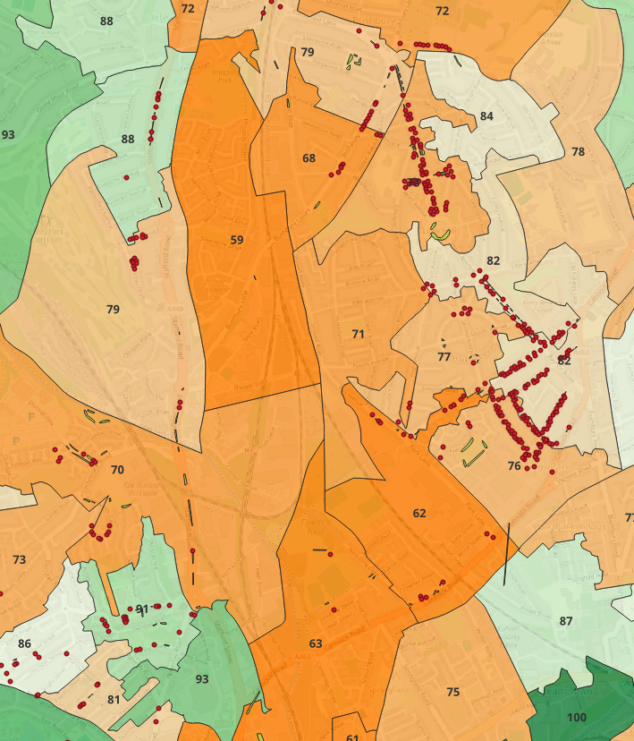



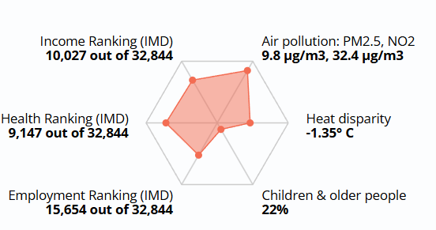
Urban greening accelerator
WMCA LINC partnered with Natural England and National Trust to develop an ‘urban greening token’ to quantify benefits of urban green infrastructure and enable investment in our most tangible urban nature.
Overview
Platform Prototype
‘Urban greening tokens’ are a tangible way for businesses to directly engage with nature in their urban spaces for the benefit of employees, clients, and the wider community
The token consists of 3x3m grid-squares containing an urban greening opportunity using What 3 Words functionality
Urban greening interventions are prioritised based on nature access and equity mapping to maximise impact
Accessibility is prioritised to unlock hard working nature on the doorstep of local business and underserved communities
Priority Interventions
The token is designed for targeted, small footprint intervention such as urban/street trees, pocket parks and urban nature enhancements²
Priority Greening
Prototype ‘urban greening token’ Platform, with intervention opportunities shown at the LSOA level¹
  Spatial environmental and social data enables targeted mapping of planting opportunities to areas of greatest need.
Tree Equity Score, Woodland Trust – areas mapped to show Tree Equity Score as a proxy for planting priority.
Defined as a small scale enhancements of urban green fabric such as a wildflower verge or green wall
52

Slide 53


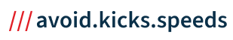
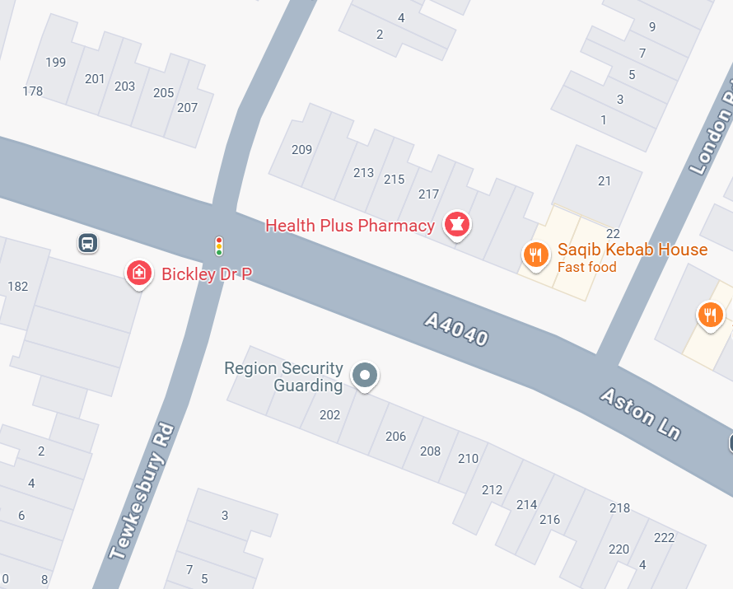
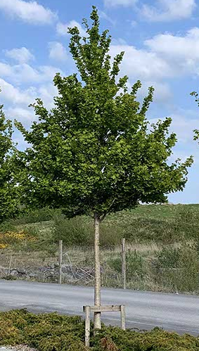
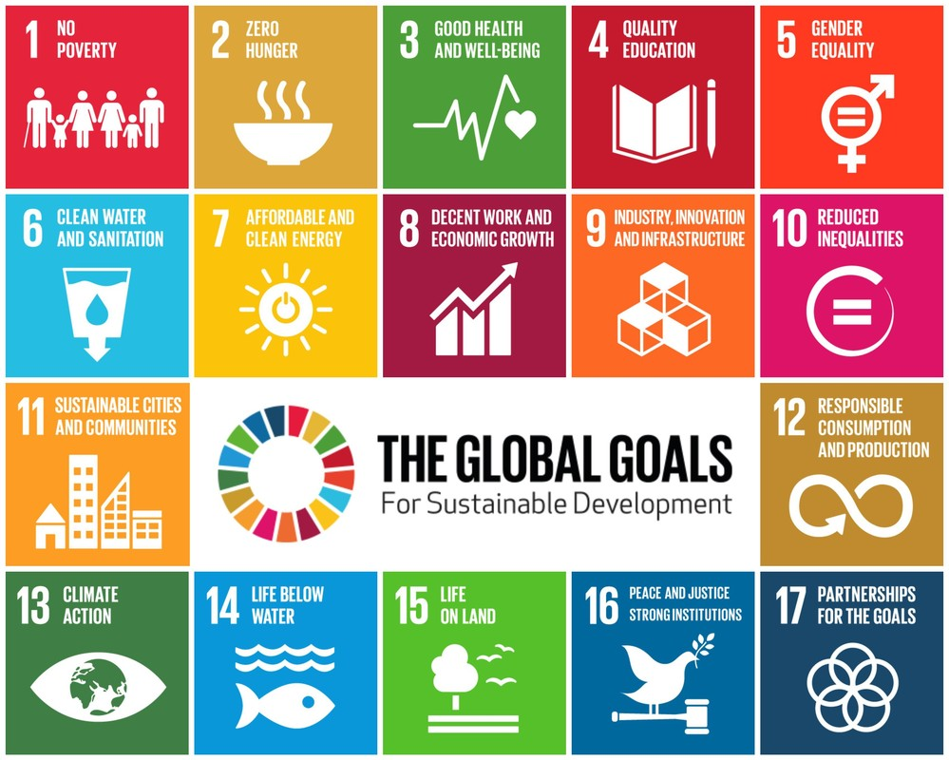
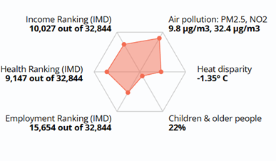
Funding for urban greening
The interface, or platform, will present spatially mapped urban greening opportunities. Each 3x3m square represents a token, and upon selecting a square, a drop-down menu of details including cost will appear.
£890
W3W Code:
Available Opportunities
Species:
Acer Campestre
Google
Streetview
SDG Benefits:
EBNT Value (30 Years):
Tokens Already Purchased
LSOA Tree-Equity:
75
LSOA IMD:
£1,300
Air Quality Regulation | ~3%
Places for Recreation | ~10%
Carbon Storage and Sequestration | ~0.3%
Flood Water Regulation | ~2%
Illustrative example of interface with drop-down menu: Map with What 3 Words overlay, with coloured squares representing funding opportunities.
53

Slide 54
Example business case: Solihull – summary outputs and programme next steps
The modelling exercise presents a compelling business case that could see significant investment if the available planting sites in Solihull are funded through the urban tree token approach. Getting these trees planted also sees a significant production of social value and benefits across the local authority.
Indicative Statistics
Benefits
Next Steps
1637 – Estimated available tree planting opportunities
~£2.6m – Total income from token sales if all sold
~£227k – Total contingency for tree failure
~£1.9m – Present value of social benefits for all trees over their lifetime from just a handful of conservatively quantified outcomes
Increased access to green infrastructure across the local authority
Ecosystem services from urban greening
Closing the funding gap to urban trees
Catalysing private sector investment for nature in cities
Process streamlining and opportunity to scale
Continue to collect tree planting costs and mapping data to build on model
Continue to conduct buyer engagement to refine approach and test product
WMCA to design and launch token platform prototype with a view to list pilot sites and conduct first transactions
NT and NE to Launch the ‘urban greening code’ to govern the market for urban greening tokens
54

Slide 55
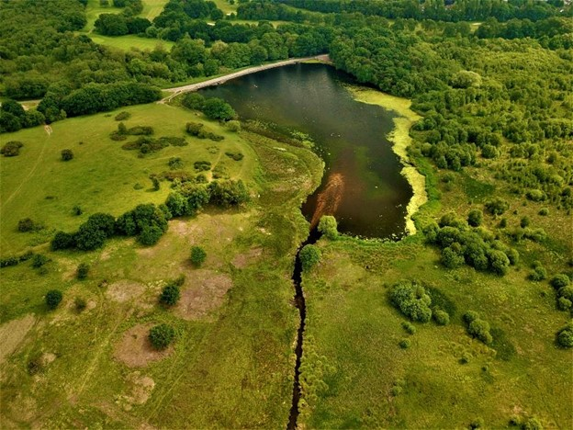
Market roles, operating models, and governance structures

Slide 56


Natural Capital Market Infrastructure
Based on structured and iterative engagement, WMCA and partners have scoped market needs and designed the natural capital market infrastructure as a framework for supporting natural capital projects access new and greater scales of funding.
Mapped market needs
Proposed natural capital market infrastructure
Funding and finance
(£179m funding gap identified, but ainsufficient revenue generating projects to secure repayable investment)
Leadership and strategic coordination
(i.e., regional BNG approach, strengthen regional environmental policies, coherent communication)
Impact marketplace
The West Midlands Nature Investment Hub will provide a direct market interface for investors, businesses, public bodies and landowners to fund ecosystem service projects and directly identify generated benefits
Scale
(i.e., reduce fragmentation to attract investment, strategic investment, risk mitigation)
Project development and implementation
(i.e., connecting projects with buyers, developing pipeline of PES projects)
Accelerator pathways
Through the natural capital market infrastructure, WMCA will operate a series of structured programmes to accelerate the development of promising and scalable ecosystem service models
Impact
(i.e., enhanced brand identity, better greenspace and habitat connectivity, aggregated projects)
Knowledge sharing and learning
(i.e., promote best practice, advance innovation, collective procurement and sharing of expert advice)
Nature market SPVs and aggregators
Where sufficient supply and demand are identified, as is the case with BNG, Special Purpose Vehicles will be established to facilitate aggregation and unlock investment at scale
56

Slide 57
Developing natural capital market infrastructure
Finance Earth and WMCA followed a structured process to design the natural capital market infrastructure to meet market needs and WMCA objectives.
Mapping market needs
Defining theory of change
Assessing market roles
Defining operating models
Assessing corporate and governance structures
Understanding of market needs was developed through market research and analysis process outlined. This was supported by detailed technical analysis and expertise.
Finance Earth co-ordinated a series of internal WMCA workshops to consider theory of change to refine objectives and functions of a vehicle.
Shortlisted market roles were assessed against agreed criteria, including market needs, WMCA risk appetite and deliverability factors.
Four key operating models were identified to meet different market needs, spanning grant focused to investible project types.
Phased delivery of models was considered based on minimising risk.
A number of corporate governance structures were assessed and tested with legal counsel.
Models were assessed with WMCA teams.
Indicative financial model produced and tested.
End Result (Phase 1): As explored in the Natural Capital Funding Framework, the establishment of natural capital market infrastructure focused on 3-4 key operating models (impact platform, accelerators, aggregation SPVs, shared service centre) alongside an overarching market leadership role. Following iterative engagement and feedback with WMCA stakeholders, it was identified that the phased development of natural capital market infrastructure, and the delayed establishment of overarching corporate governance models, would allow for a leaner and lower risk development journey.
57

Slide 58
natural capital market infrastructure - potential roles
Several potential roles were identified that natural capital market infrastructure could play to facilitate the flow of green finance. These roles are not mutually exclusive and could be combined.
1
Convenor – connecting stakeholders and sharing resources with stakeholders
6
Strategic planner – ensuring alignment with local and regional policies and strategic priorities
2
Project developer – identifying project opportunities and securing funding for projects
7
Funder/ investor – repayable and non-repayable capital provision for natural capital projects
3
Advisor – provide template resources or bespoke support to help stakeholders develop projects
8
Ecosystem service broker – connect projects with potential buyers to enable sales
4
Aggregator/ market coordinator – aggregates and matches projects and plays a central funding role
9
Ecosystem service buyer – purchases ecosystem services e.g., carbon credits/BNG units
5
Quality assurer – confirming integrity of nature recovery actions and vetting buyers and investors
10
Responsible body – oversees and ensures compliance with BNG conservation covenants
58

Slide 59






Assessment criteria
The potential roles that natural capital market infrastructure could undertake have been evaluated against 5 criteria.
Need
How much demand is there for the role and what is the potential impact of the role?
Technical
feasibility
How practical is this role for the WMCA given its skills, resources and networks?
Cost and commercial opportunity
How viable is the business model and do revenue streams exist to cover costs?
Opportunity for scale
What WMCA wide benefits could this role potentially provide?
Risk for WMCA
What risks exist for taking on this role and to what degree can they be mitigated?
59

Slide 60
Assessment of operating models and governance structures
A spectrum of financing opportunities and governance structures were considered for the natural capital market infrastructure. They present varying levels of opportunities and risks.
Governance and Strategic Decision Making | Status Quo | Reorganisation/ Partnership approach | Wholly owned subsidiary | Independent legal structure
Funding and Financing |  | Centrally funded and controlled | Central budget and independent control of spending | Revenue independence
Ownership |  | Managed in-house | Leased to independent vehicle | 3rd party commercial control
Operational Management |  | Pooled in house resources | Managed by independent vehicle | Subcontracted to 3rd Party
60

Slide 61
Special Purpose Vehicle options
There are a range of corporate vehicle options, and legal advice has been sought to develop this further in the next phase of LINC.
 | Company Limited by Shares | Company Limited by Guarantee | Community Interest Company (CIC) | Co-operative | Charity
General use case | Most frequently adopted corporate legal structure, flexible | Primarily used for not-for-profit structures, e.g. charities | Used specifically for social enterprises | For co-operatives that serve members’ interests | Set up for a wholly charitable purpose and for the benefit of the public
Set-up and formation | Fast, simple and cheap | Fast, simple and cheap; registering as a charity can be a slow process | More complex, timely and costly | Complex, timely and costly | May be a slow process; can take the form of a Charitable Incorporated Organisation (CIO)
Liability | Limited liability for shareholders | Limited to any member guarantee | Same as limited companies | Limited liability for members | Managed by trustees who have legal duties
Regulation and reporting | More strict filing requirements and regulation | More filing requirements and regulation, especially as Charity | More strict filing requirements and regulation | Less strict filing requirements | Registered and regulated by the Charity Commission
Distributions permitted | Yes | Typically no (articles can permit distributions if not a charity) | Yes, if limited by shares, limitations over value/ % | Yes | No
Asset lock | Bespoke drafting in articles | Bespoke drafting in articles | Yes | Bespoke drafting in articles | Yes
Charitable status | No | Yes | No | No | Yes
61

Slide 62


Roadmap to 2030
DEFRA’s theory of change sets the strategic ambition to implement system-level change by 2030. Subject to funding, this proposed roadmap sets out the activities and decision-making required to establish natural capital investment facilities in a phased approach to unlock finance for nature over time.
LINC Phase 1: Development and testing
LINC Phase 2: Implementation
LINC Phase 3: Scale-up investment and funding
Assets and opportunities measured and evaluated
Nature-positive economy contributing to UK and regional targets for the environment and Net Zero.
Market infrastructure operationalised
Market research: supply and demand
Natural capital accounting
Build capacity and capability
Develop pipeline and aggregation models
Assess operating models and governance
Pilot projects to test nature markets
Develop & launch Nature Investment Hub
Unlock funding and investment
Ongoing investment readiness support for pipeline projects
Provide ongoing technical support
Integrate LNRS and LINC with other spatial priories, strategies, and tools
Identify new market opportunities
Business case & approval for BNG delivery mechanism
Operationalise BNG habitat bank
2025
2027
2030
Build the system architecture for a regional funding ecosystem which supports nature recovery, climate adaptation, and inclusive growth
62

Slide 63
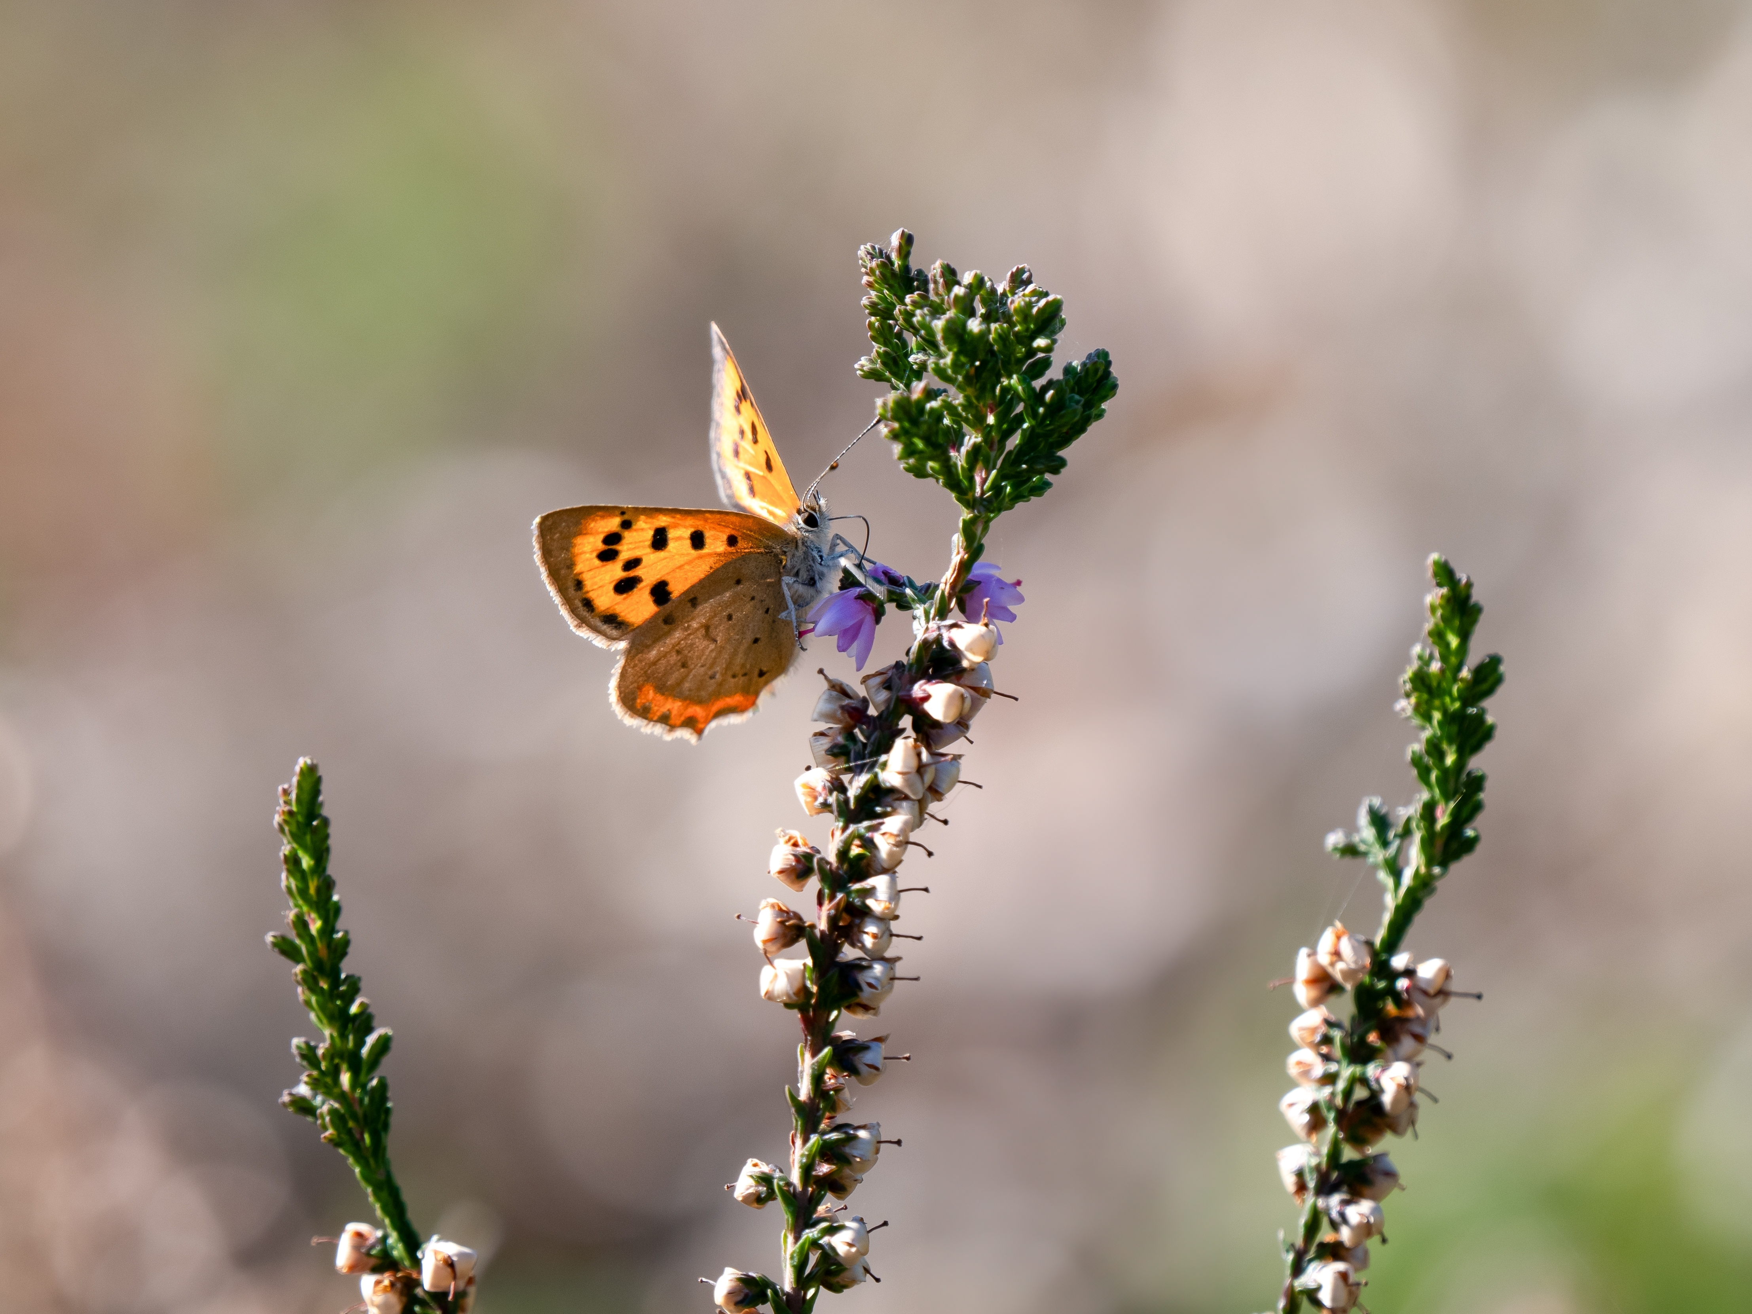
Conclusions & lessons learnt

Slide 64
Effective engagement with investors, funders, and buyers requires an integrated strategy across regional delivery stakeholders to prevent market confusion, to establish scale, and protect credibility.
Developing regional-scale pipelines and platforms amplifies project visibility and unlocks a broader spectrum of funding opportunities, enabling projects to access a wider investment landscape.
A regional-scale framework supports more effective stakeholder collaboration, facilitating greater alignment of efforts both spatially and thematically.
Despite high levels of ambition, substantial gaps in supply-side capability and capacity remain major obstacles to developing projects that are ready for investment.
Establishing the supply side of a regional natural capital market is a long-term endeavour, requiring deep stakeholder engagement, committed resources, and up-front funding.
Scalable mechanisms like aggregation and unit-based tokens increase project flexibility, enabling market participation across a broader spectrum of price points.
Key supply-side lessons

Slide 65
Corporate interest in nature related impacts is growing, and predominantly motivated by organisational mission, customer demand, and financial resilience, but lags behind explicit net-zero action.
Analysis indicates that corporate ESG/CSR funders most commonly prefer price points in the £10,000 to £100,000 range.
The proximity of natural capital interventions to company premises, supply chains, and local communities constituted the primary criterion for project selection.
Unlocking financial support for non-revenue generating projects requires a clear, measurable social value framework and a powerful narrative.
Corporates cited the policy and regulatory landscape as key reasons for non-engagement in nature markets, with limited demand drivers or understanding of benefits.
Businesses favour projects with a strong social value element and the incorporation of nature-based solutions for climate change.
Key demand-side lessons

Slide 66
Lack of Mandate: A mandate is critical to deliverability. A mandate was not developed within WMCA in advance and nature is siloed from wider growth and social leadership priorities.
Scale, Complexity & Timelines: Timeframes were insufficient to both build mandate and develop a governance structure across multiple local authorities. It was difficult to move at the required pace due to scale, uncertainty, complexity, and decision-making timelines inside public sector organisations. This period has been a very valuable discovery phase. Momentum and learnings should be carried forwards with a sustainable core funding plan running to 2030.
Resourcing Constraints: Resourcing in LAs around public space, the environment, and planning, is constrained and is further impacted by recent and ongoing changes in policy and legislation. This makes engagement and co-operation difficult.
Multi-skill challenges: Even where LA teams can engage, it is hard to consult with wider LA teams (legal, finance, governance). This makes it hard to build organisational mandate for a complex multi-disciplinary programme looking to establish system-level change at a regional scale.
Resource intensity: Building a pipeline which includes over 200 projects is complex, and only more so when operating across diverse organisations and themes in a sector unfamiliar and uncomfortable with repayable finance.
Market maturity: Markets remain significantly immature, and further support is required from UK Gov / DEFRA to create demand. Opportunities do exist, while willingness to pay is inconsistent, DEFRA has shown, with BNG that designing markets is possible.
Corporate engagement: End of financial year is often the worst time of year for engagement. Corporates are interested in pro-bono. Larger corporates care more about Social Return on Investment quantification.
Key challenges

Slide 67
Mandate building: DEFRA alignment with CA leadership to build consensus over theory of change ahead of programme would have enabled greater progress.
Devolved Powers and Responsibilities: Further devolution of powers and responsibilities provided to CAs should in turn increase LA engagement.
Sandboxing Approach: CA / Regional devolved bodies are the right scale to innovate through sandboxing to trail and accelerate a range of potential market interventions.
Innovation: Private sector innovation is based on repeated and rapid failure. CA/LAs should be facilitated to take controlled risk through "ringfenced" innovation.
Technical Assistance Programmes: TA programmes are most efficient operated as innovation/ investment readiness cohorts (structured, centralised support programmes), to minimise duplication. Both Accelerators made valuable progress.
Public Sector Procurement: Procurement can restrict agile working. Increased flexibility over smaller contracts could add value to rapidly procure targeted support. Resourcing: Significant additional resourcing within the LINC team to build capacity and unlock supply of regional projects. This should include a pipeline officer function. Demand: For established markets, DEFRA should stimulate demand, or work with combined authorities to identify suitable levers at a local level (e.g. variable BNG % requirements).
More nature markets needed: Government to map economic reliance of sectors (water, health, resources), identify desired interventions, support local plan development and encourage willingness to pay by removing barriers / providing incentives to market based approaches.
Regional spatial planning and increased CA powers to lead strategy: LNRS development has significant potential but should be aligned to a broader mapping of key criteria and spatial attributes. This can include everything from environmental equity to utility surveys.
Defra engagement: Direct embedding of DEFRA staff could improve the translation of learnings.
Utilise LNRS to convene stakeholders, provide strategic coherence, provide spatial and thematic priories, and as a driver for establishing delivery and funding infrastructure at a suitable scale.
Recommendations

Slide 68
Testimonials
“At Warwickshire Wildlife Trust we have found the LINC project an invaluable opportunity to access alternative funding for our works. The opportunity available via the LINC programme has the potential to create new partnerships ultimately resulting in more projects being delivered in the right place.
The set-up, discussion with project owners, feedback and final result of the “project pipeline” was very well delivered and has given a great framework to now move projects through. After all the hard work and effort put into this we would hope that it will remain, along with the staff support, to enable those projects to get through the pipeline and obtain funding.”
Susan Hartland Smith - Tame Valley Wetlands Manager, Warwickshire Wildlife Trust
"The LINC process set up at WMCA has opened our eyes to the opportunities for funding and the processes involved. We have a pipeline of projects, we know what we need to do to get them further and how they fit into funding categories As a local planning authority we can see the benefits that can be gained and we can see a future for this working with the WMCA. There is a pathway present for us to engage further and make more of, with relationships forged to build upon this further for our residents and our natural environment’s future".
Natalie Walker – Senior Development Officer, Solihull Metropolitan Borough Council
“Natural England, in collaboration with third and private partners are building an exciting proposal to drive investment in nature recovery at a pan-regional scale. The work that WMCA LINC programme have developed is of major significance to this work. The Pilot studies, such as developing pipelines of projects for investment, along with the knowledge sharing that LINC team members are providing, is helping accelerate our learning and innovation efforts.”
Adam Tunningley - Director of Operations, Natural England
“The LINC process has been invaluable in enabling the team at Canal and River Trust to consider how we can best understand the private finance model and how our aspirations for the waterways align with these opportunities. The support from LINC team has been highly professional throughout and has also enabled us to organise our priorities into themes and associated costs which has been a very useful exercise for us. We definitely could not have done this without the LINC support.”
Peter Hoarle – Enterprise Manager, Canal and River Trust

Slide 69



Get involved
The West Midlands LINC programme is seeking to work with you to deliver for our natural environment and communities. Please get in touch with our team to understand how you can be part of the journey:
Please get in touch if…
1
you are a business or funder and would like to find more about natural capital projects and investment opportunities in the West Midlands.
2
you have a project and are looking for funding, investment, or technical support;
Email:
Nature.Hub@wmca.org.uk
Or visit our webpage for resources and more information: https://www.wmca.org.uk/what-we-do/environment-energy/natural-environment/local-investment-in-natural-capital/
3
you own or manage land in the West Midlands and are interested in exploring natural capital opportunities

